Slide 1






Community Behavioral Healthcare Association of Illinois
2017 Medicaid Managed Care for Children in Foster Care:
What are the challenges and lessons learned from other states?

Slide 2
Outline for Today’s Presentation
Key trends (some repetition from last time we met)
Medicaid foster care spending
Medicaid foster care behavioral health service utilization
EPSDT
State Examples
Working together – state agencies, MCOs, providers and families
Network solutions – payment along the continuum

Slide 3
Key Trends
Children’s Behavioral Health Medicaid Spending
  About 10% of the 29 million Medicaid enrolled children use any form of behavioral healthcare and behavioral healthcare accounts for about 38% of the total (PH ad BH) Medicaid expenses for all children.
Foster Care and Medicaid
  427,920 children in foster care as of September 30, 2015 (AFCARS report, June 2016)
  All children in foster care and receiving maintenance payments under Title IV-E or state maintenance payments are eligible for Medicaid. This also means their behavioral health needs are covered, too
  All children who were in foster care upon turning 18 are now eligible for Medicaid until the age of 26 (ACA changes effective January 1, 2014). Approximately 20,000 young adults transition out of foster care each year and will be newly covered.
  Foster care population is 3% of the Medicaid child population (871,500)
  Medicaid spending for the population in 2005 was $10.5 billion; $14.2 billion in 2014 when adjusted for medical inflation
High rates of out-of-home placements; high poly-pharmacy rates
Behavioral health spend for children in foster care is higher than physical health spend
CHCS Identifying Opportunities to Improve Children’s Behavioral Health Care: An Analysis of Medicaid Utilization and Expenditures, Faces of Medicaid Data Brief, December 2013

Slide 4
Key Trends
1 in 3 children in foster care use behavioral health services
Foster care represents 3% of the children in Medicaid, 15% of those using behavioral health services and 29% of Medicaid expenditures for children’s behavioral health services
Source: CHCS Fact Sheet – Medicaid Behavioral Health Care Among Children in Foster Care, June 2014

Slide 5
Children’s Medicaid Behavioral Health Spending Trends – Mean Annual Expense/1
Foster Care and Other High Cost Populations
2005 and 2014 (indexed for inflation)
Children in top 10% of BH expense are nearly 6x more expensive than Medicaid children in general
$28,000 BH / $20,000 (PH)
$48,000 (2005)
$64,654 (2014)
SSI-enrolled/disabled:
$7,264 BH / $7,895 PH
= $15,158 (2005)
= $20,417 (2014)
Children in Medicaid Using Behavioral Health Services are an Expensive Population
$3,238(BH)/$5,284 (PH)
= $8,520 (2005)
= $11,476 (2014)
Foster Care enrolled:
$8,094 BH / $4,036 PH
= $12,130 (2005)
= $16,338 (2014)
TANF enrolled:
$3,029 BH / $2,053 PH
= $5,082 (2005)
= $6,842 (2014)
BH spending for
the foster care
population is more
than 2x greater
than PH spending
1-2005 Medicaid data; all children in Medicaid N = 29,050,305; children receiving BH services N=1,958,908; top 10% with highest BH = 121,323
(CHCS Fact Sheet – Medicaid Behavioral Health Care Among Children in Foster Care, June 2014)

Slide 6
Medicaid Foster Care Spending – Two Different Perspectives
 | Mean Expenditures /1
 | Children in Foster Care | %
Behavioral Health Services | $8,094 | 67%
Physical Health Services | $4,036 | 33%
Total Health Services | $12,130 | 100%
 | Total Expenditures Arizona CMDP / 2
 | Children in Foster Care | %
Behavioral Health Services | $203,377,797 | 83%
Physical Health Services | $40,825,568 | 17%
Total Health Services | $244,203,365 | 100%
In the foster care population, behavioral health spend is between
67% and 83% of total Medicaid spend.
1 - Pires, Grimes, Allen, Gilmer, Mahadevan, 2013, Faces of Medicaid Examining Children’s Behavioral Health Service Utilization and Expenditures, CHCS, Hamilton, NJ
2 – AHCCCS CMDP Updated Actuarial Memorandum effective October 1, 2015; AHCCCS, DHS/DBHS Actuarial Memorandum effective October 1, 2015

Slide 7
Foster Care Spending
A possible explanation for variance in perspective has to do with spending by State Child Welfare agencies.
Some State Child Welfare agencies spend Title IV-E on services that could/should be paid by Medicaid
Federal appropriation for Title IV-E in FFY2015 was $7.1 billion

Slide 8
Medicaid Foster Care Behavioral Health Service Utilization
More likely to have access to restrictive and expensive behavioral health services such as residential treatment/therapeutic group care, inpatient psychiatric and emergency room which are costly and preventative
Few children in foster care and Medicaid overall, receive home and community-based services, MST or other effective treatments
Children in foster care are prescribed psychotropic medications (anti-psychotic's, anti-depressants and anti-obsessive agents) at a rate 4 times higher than the general Medicaid child population and more often receive multiple psychotropic medications.
In fact, close to 50% of children in foster care are prescribed two or more psychotropic mediations in the same year.
And, 49% of children who were prescribed psychotropic medications did not receive another behavioral health service. Mean expenses per child:
  $934 per child mean expense per child, foster care
  $916 per child, for those with SSI
  $475 per child, for TANF children

Slide 9
EPSDT is a mandatory benefit
Early and Periodic Screening, Diagnosis and Treatment: an entitle benefit given to children eligible for Medicaid within mandatory eligibility groups
Designed to cover all medically necessary care for children, in recognition of their unique needs
States must fully cover preventive and primary care, including dental, hearing, vision care and all acute care services. Behavioral health services are “acute care” services
The EPDST benefit also addresses long-term needs associated with children with special healthcare needs – including therapies, medical equipment and other support services.

Slide 10
EPSDT is extremely broad
States must provide all services to children, even if that services in not available to adults
States may not impose arbitrary limits on EPSDT services
States may only deny and EPSDT benefit when it is not medically necessary, or is deemed experimental/cosmetic
Heavily interpreted/sometimes conflicted federal statute
Approximately 15 states with EPSDT court decisions, others percolating
Jason K., Katie A., Rosie D.. N.B. v. Hamos

Slide 11
Good examples of advancement in children’s behavioral health and foster care
Michigan – CC360
Wraparound Milwaukee
Arizona Child and Family Team – EPSDT lawsuit driven
Massachusetts Child Psychiatry Project
New York RFA – phased in for Foster Care
Ratios in Systems of Care – Technical Assistance Network

Slide 12
Michigan ConnectCare360
What began as a tool to integrate physical and behavioral health data has evolved into something broader — and Michigan foster care children are among those who will benefit.
Michigan’s CareConnect360 (CC360), a statewide Web portal and care management tool developed by the Michigan Department of Health and Human Services (MDHHS) to integrate physical and behavioral health-related information — along with other human services data — to provide a comprehensive view of an individual’s care needs.
In a first-of-its-kind initiative in Michigan, CC360 was initially rolled out to the state’s health plans that serve Medicaid beneficiaries as a way to close a significant gap in the care continuum — prior to the implementation of CC360, health plans offering behavioral health services (Pre-paid Inpatient Health Plans or PIHPs) did not have access to a member’s physical health information; and Medicaid Health Plans (MHPs), which provide physical health services, had no insight into a patient’s mental illness or developmental disabilities. CC360 integrated the physical and behavioral data, enabling health plans to integrate care.

Slide 13
Wraparound Milwaukee
Program Description
A unique system of care for children and adolescents with serious emotional, behavioral and mental health needs in Milwaukee County, WI, serving about 1,500 families a year
Provides a comprehensive array of mental health and support services which are organized into coordinated networks across child-serving systems
Value and strengths based, value driven, one family – one plan
Child and family team composed of informal/natural supports (50%) and formal/professionals (50%) members that meet as often as needed
Uses a flexible pooled funding approach
Uses its own electronic medical record that links all providers, payments, services and plans
Results
Inpatient stays reduced from 5,000 days per year to 500 days per year
Average daily residential treatment reduced from 375 to 80 placements
Average cost is $3,700 per month in Wraparound Milwaukee versus $9,000 per month for residential, $8,000 per month in a correctional placement or $1,200 per day in psychiatric inpatient.¹
¹ Bruce, Kamradt , February 9, 2011 Treating Children with Serious Mental Health & Behavioral Health Needs Through Systems of Care – An Introduction to the Wraparound Milwaukee Model. Centre Perth, Australia.

Slide 14
Arizona Child and Family Teams, Tiered Care Coordination, Practice Protocols
Program Description
Arizona has used its 1115 waiver to expand Medicaid covered services for children with heavy emphasis on:
  Medicaid coverage of family support and parent partners
  Increase access to independent specialty providers
  Collaboration with natural and temporary families, child welfare and justice
Arizona created a separate capitation rate and financial reporting for children enrolled in the Department of Child Safety and managed through BHOs (Regional Behavioral Health Authorities). Possibility of moving BH to DCS.
No prior authorization for lower costs services, team decision making
Developed specific practice guidelines for child and family teams, youth in foster care, and birth to 5 populations
Using tiered level of care guidelines – intensive case management, supportive case management
Results
Reduced out-of-state placements from 240 to 20 over two years1
1 Source: “Interview with Leslie Schwalbe, former Deputy Director, Arizona Department of Health Services, Division of Behavioral Health Services, August 2015.”

Slide 15
Massachusetts Child Psychiatry Project (MCPAP)
Program Description
An insurance-blind universal behavioral health screening program that connects PCPs with real-time telephonic consultation with child psychiatrists within 30 minutes; face-to-face appointments for acute psychopharmacology or diagnostic evaluation; and assisting PCP and families with accessing community-based behavioral health services when needed
Meets the psychiatric consultation needs of all 1.5 million children living in Massachusetts
6 regional teams made up of a child psychiatrist, licensed therapist and care coordinator
61,200 + phone calls from PCPs
22,900 + face to face psychiatric evaluations
Annual budget $3.3 million
www.mcpap.org

Slide 16
New York’s evolving model of care
2.4 million children are enrolled in Medicaid in NY, representing 37% of the Medicaid population.
The majority are enrolled in managed care for their physical health services, but most behavioral health (BH) services are delivered on a FFS basis.
Responsibility for Children’s BH services is divided among an array of State and county agencies and care is provided across many different settings with little coordination among them
Sub populations of children with very specific needs: Children with SED, Foster Care, Juvenile Justice, Transition Age Youth
Coordination between multiple state and local systems of care and the schools is a challenge, although the State recognizes it is critical in working with kids, particularly those with high need in addition to working with families.
Under the proposed program OMH, DOH, OASAS and OCFS are all coordinating. Looking to gain involvement from Department of Education and Juvenile Justice.

Slide 17
New York’s evolving model of care goals
Intervening early in the progression of behavioral health disorders is effective and reduces cost.
Accountability for outcomes across all payers is needed for children’s behavioral health.
Solutions should address unique needs of children in a unified, integrated approach.
The current behavioral healthcare system for children and their families is underfunded.
Children in public or private health plans should have access to a reasonable range of behavioral health benefits.

Slide 18
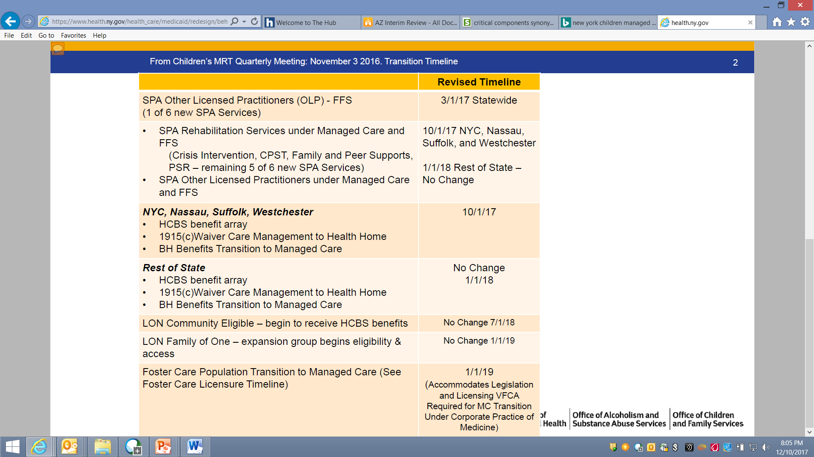
New York’s evolving model of care

Slide 19
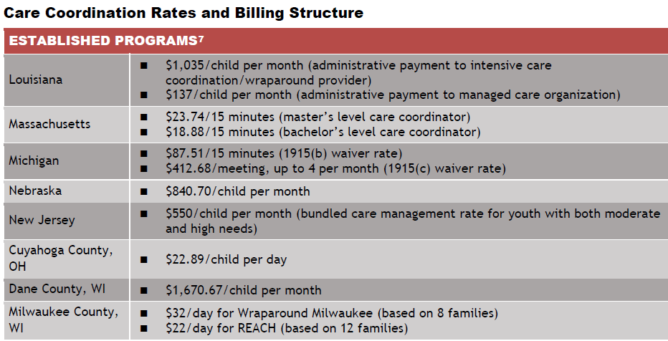
Medicaid Scan – Technical Assistance Network and Center for Health Care Strategies

Slide 20
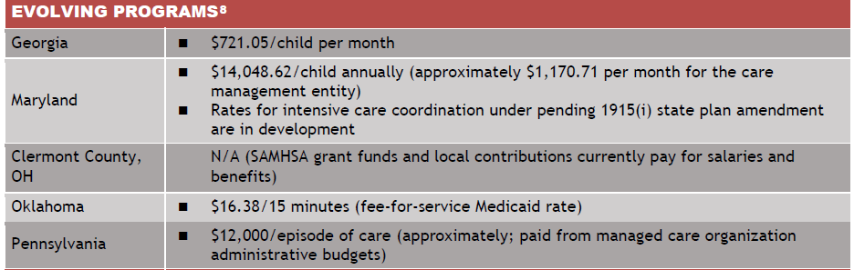
Medicaid Scan – Technical Assistance Network and Center for Health Care Strategies
Care Coordination Rates and Billing Structure

Slide 21
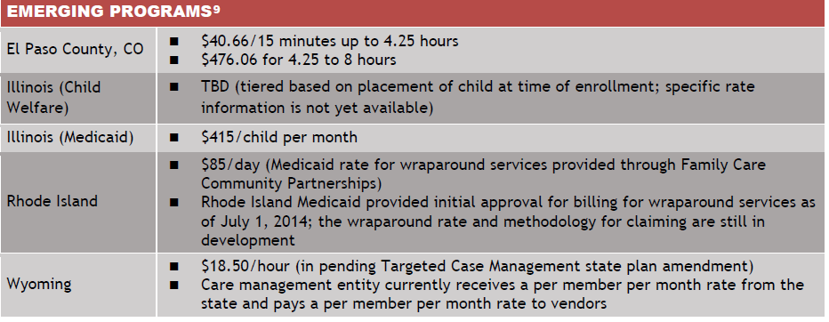
Medicaid Scan – Technical Assistance Network and Center for Health Care Strategies
Care Coordination and Billing Structure

Slide 22
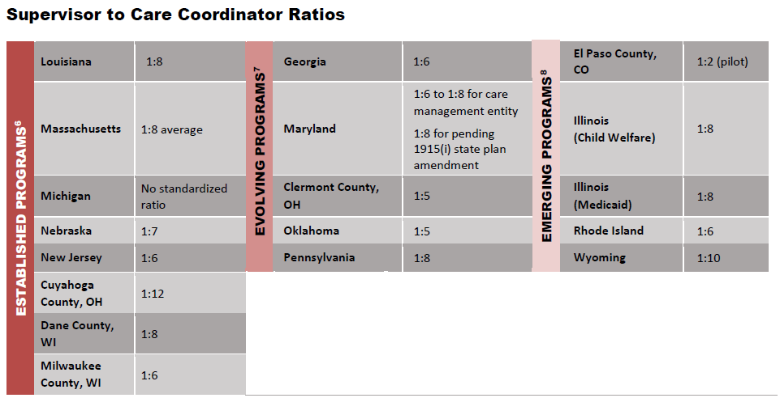
Medicaid Scan – Technical Assistance Network and Center for Health Care Strategies
6 “Established” programs are those that are fully established, with sustainable funding streams and a full array of services and supports for children with behavioral health needs. They also have outcomes data (some publicly available) and are involved in continuous quality improvement.
7 “Evolving” programs are those in states/communities that have established intensive care coordination programs using wraparound in regions of the state and are either: (1) expanding statewide; or (2) revamping their approach to intensive care coordination using wraparound, often within the context of utilizing new Medicaid strategies, in order to enhance and sustain their programs.
8 “Emerging” programs are those being piloted or in the early stages of implementation.

Slide 23
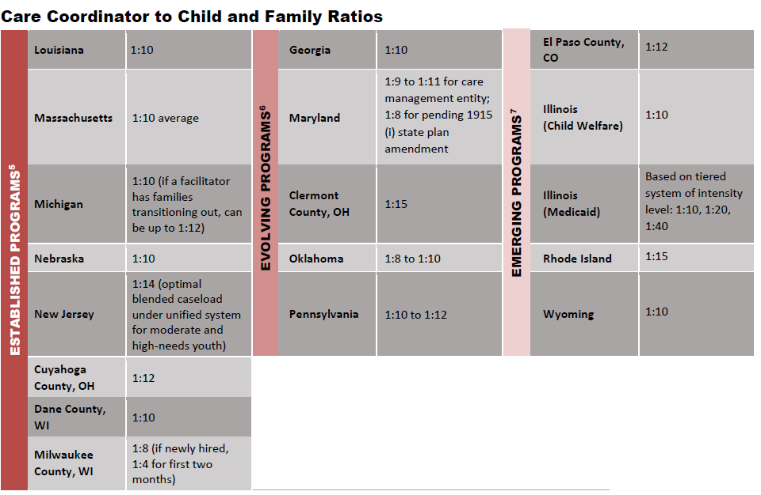
Medicaid Scan – Technical Assistance Network and Center for Health Care Strategies

Slide 24
Network Strategies

Slide 25
MCO and Provider Competencies Must Evolve for Children with Multiple Complex Needs
Complex and high cost populations need specialized trained provider types and systems to be maximally effective
Research has shown in many areas that highly trained clinicians have better outcomes than care through a generalized care provider (particularly in EBP implementation)
Current generalized training and licensure does not clarify experience nor competence for these populations
The system of care will need to have processes to measure and identify competencies
Must consider alternative care providers tailored to this unique population
Strengths-based Planning
Co-occurring Disorders (MH/SUD)
Family Involvement-preferences
Trauma-Informed Care
Care Coordination
Specialized Clinicians
Supporting Interagency Protocols
Foster Care and Justice Involvement
Behavioral/ Medical Integration

Slide 26
Transitioning to Managed Care should be carefully planned
Establish working partnerships across child-serving agencies
Implement successful strategies to engage youth, young adults and families
Develop meaningful quality measurement for children and families
Address the needs of transition-aged youth and young adults
Integrate with Children’s health homes
Differentiate and address the needs of children in child welfare and juvenile justice
Develop clinical competencies to serve multi-agency involved children with multiple complex needs
Ensure family and youth involvement
Family driven and youth guided approach
Strengths-based and trauma-informed care
Incorporate technology such as telepsychiatry and smartphone apps

Slide 27
Transitioning to Managed Care should be carefully planned
Data stratification and analytics
Identify existing care coordination capabilities for these populations
Clinical model adoption for foster care population especially for SUD conditions and justice-involved youth
Network development and payment strategies for specialty populations including those organizations that are not far along the readiness spectrum
Understand and manage transitional services

Slide 28
Provider Engagement in Transition to Managed Care
MCO’s role: Transparency, collaboration and effective implementation
Engage provider community in early stages of change
  Understand provider stressors, strengths and limitations
  Clear readiness review tools and expectations before, during and after implementation
  Engage early adapters, provider leaders in NY to lead transformation
  Frequent & accurate communications – foster a two-way, continuous dialogue
Train providers in managed care transactions, state-approved initiatives, child / family team and health home approaches,
When necessary, consider phased implementation for major state-approved measures
Use an experienced network managers, utilization management specialists and transformation specialists to assist with claims payment, UM and practice guidelines, health home infrastructure development, data sharing and reporting
Serve as a resource in navigating complex benefits and services
Anticipated Results
Providers view MCOs as partner
MCOs incentivize collaboration
Providers and MCOs part of the same team in meeting the goals of the State, children and their families
MCOs measure outcomes using provider-centric data and tools
Providers have access to data to improve performance and move to the next level in keeping with the State’s goal regarding Pay for Performance

Slide 29
Our work in the reimbursement continuum
Small % of financial risk
Moderate % of financial risk
Large % of financial risk
Fee-for-Service
Performance–Based
Contracting
Shared
Savings
Bundled
and Episodic
Payments
Shared Risk
Capitation
Capitation and
Performance-
Based
Contracting
Low Accountability
Moderate Accountability
Maximum Accountability
EXAMPLES
P4P/Shared Savings Contracts with Qualified Facilities and Outpatient Providers
(national footprint across all payer types)
SUDS Medication Assistance Therapy (MAT) Providers — MA
Leverage medical-behavioral integration in health homes (payer customers)
METRICS
Outpatient
Quality: Case-mix adjusted member-reported outcomes (wellness assessment)
Cost: Case-mix adjusted average
visits per episode
and episode cost
Inpatient
Quality: HEDIS
7-day follow-up; CMS Readmission Rate for 30 and 90 day (case mix adj)
Cost: Case-mix adjusted ALOS and episode cost
Quality: Readmit rate (case-mix adjusted) – 30 and 90 day
Cost: Case-mix adjusted average visits per episode and episode cost
8 metrics across 6 domains
Care coordination
Care transition
Referral management
Health promotion
Individual support
Family/caregiver support
RESULTS
15% to 20% reduction in readmit rates
Ambulatory follow-up rate improved from 3% to 10%
TBD – launched 11/2014
Early results (government program) show improved care coordination
  9% increase in adherence to quarterly PCP visits
  4% increase in primary caregiver
  or peer support linkages

Slide 30
Driving better results for the health system
UnitedHealth Group is a distinctly diversified enterprise based on three foundational competencies – clinical insight, technology, and information – to help people live healthier lives and help the health care system work better for everyone. By leveraging our two complimentary but separate platforms, UnitedHealth Group is creating a more aligned, innovative, and efficient health care system.
Health Benefits
Health Services
Helping people live healthier lives
Helping to make the health system work better for everyone

Slide 31
Questions / Conversation
Leslie Schwalbe, MPA, CCHC
SVP State Government Programs
Leslie.schwalbe@optum.com
(480) 838-5015 (office)
(480) 766-6479 (mobile)
Tempe, AZ

Slide 32
Appendix

Slide 33
Most common diagnosis among Medicaid foster care and
Medicaid non-foster care age 0-17
‡ Based on Clinical Classification Software (CCS) ICD-9
Source: Center for Mental Health Services and Center for Substance Abuse Treatment. Diagnoses and Health Care Utilization of Children Who Are in Foster Care and Covered by Medicaid. HHS Publication No. (SMA) 13-4804. Rockville, MD: Center for Mental Health Services and Center for Substance Abuse Treatment, Substance Abuse and Mental Health Services Administration, 2013.

