Slide 1
Illinois School-Based Health Centers
Keeping Students Healthy, Safe, and Ready to Learn

Slide 2
^{VISION}
EverThrive Illinois envisions an Illinois that works towards equity and social justice, fosters the development of healthy families, and provides fair access to quality health care – the basic rights of all human beings.
^{PRIORITY AREAS}
^{Child and Adolescent Health}
^{Healthy Lifestyles}
^{Health Reform}
^{Immunizations}
^{Maternal and Infant Mortality}

Slide 3
Illinois School-Based Health Alliance (ISBHA)
MISSION: The Illinois School-Based Health Alliance (ISBHA) works to ensure that children and adolescents are healthy, safe, and ready to learn by advocating for and supporting school-based health centers (SBHCs) as school and community assets.
GOALS:
Advocacy
Training & Technical Assistance
Sustainability & Growth

Slide 4
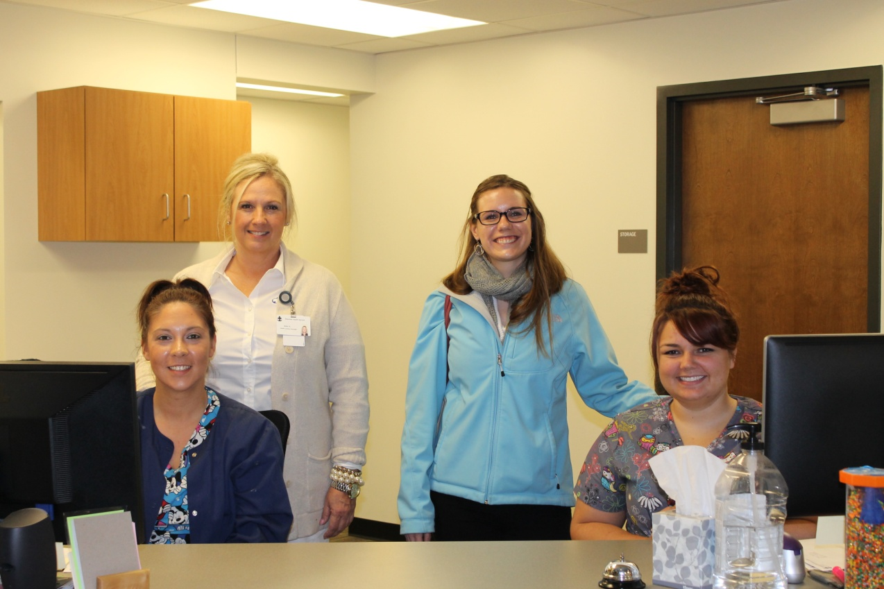
GOALS
Understand the SBHC model and how it serves as a behavioral health access point for youth across IL
Start a conversation – How can we partner?

Slide 5
OVERVIEW
A snapshot of need
The SBHC model
SBHCs in IL
ISBHA’s behavioral health initiatives
Partnership

Slide 6
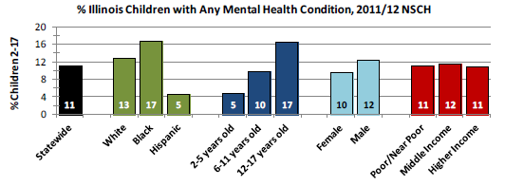
A SNAPSHOT OF NEED:
*2015 Illinois Maternal and Child Health Needs Assessment, IDPH

Slide 7
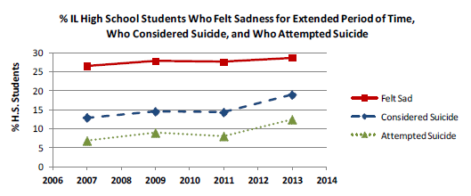
A SNAPSHOT OF NEED:
*2015 Illinois Maternal and Child Health Needs Assessment, IDPH

Slide 8
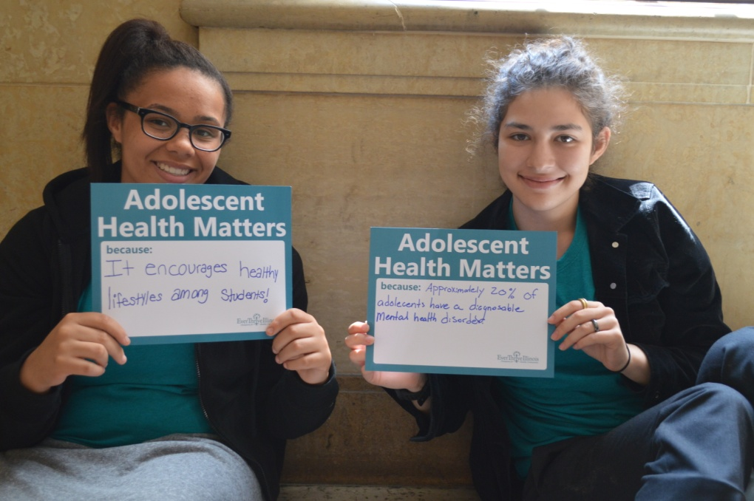
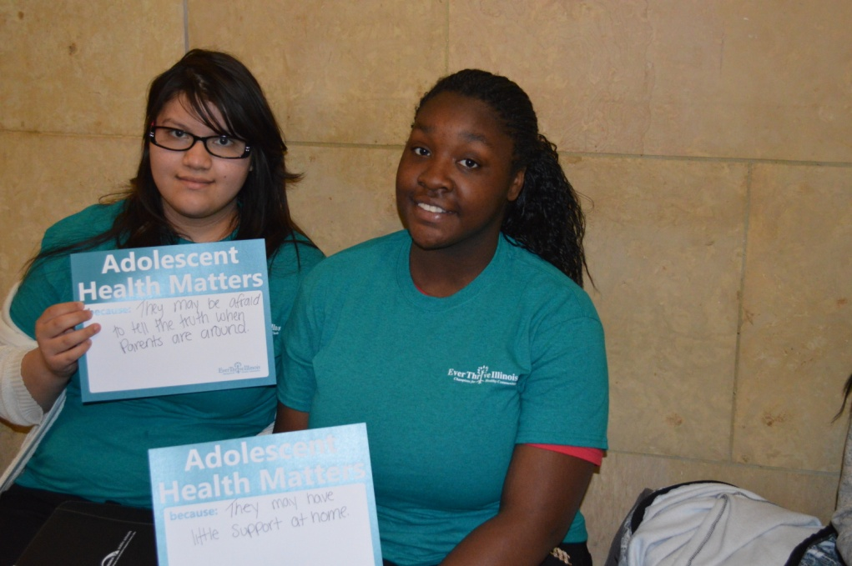
IN ILLINOIS…
29% of adolescents felt sad or hopeless for a period of at least 2 weeks during the last 12 months (YRBS, 2015)
16% of adolescents seriously considered attempting suicide (YRBS, 2015)
10% of adolescents attempted suicide at least once during the last 12 months (YRBS, 2015)
41% of children and adolescents with a mental/behavioral condition did not receive treatment or counseling (NSCH, 2016)

Slide 9
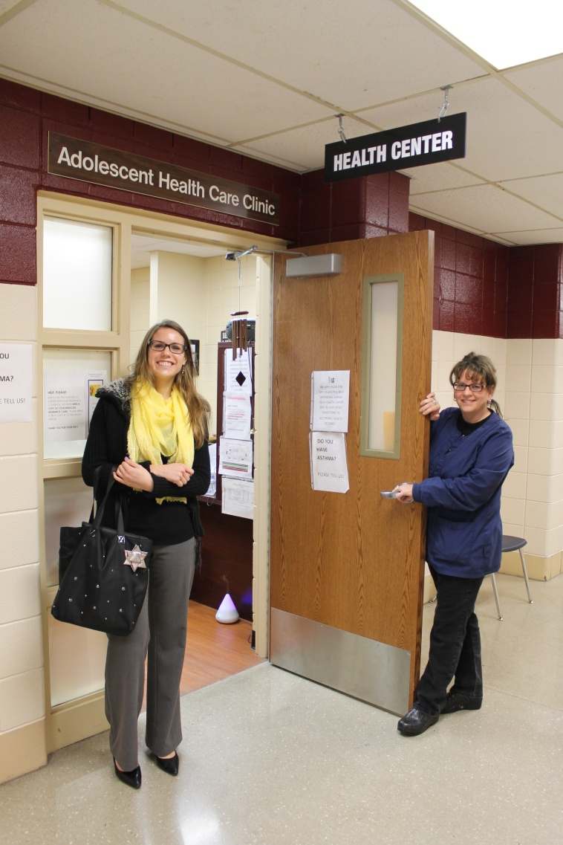
THE SBHC MODEL
SBHCs are primary care offices in or near a school.
Scope of Services:
Health education
Immunizations
Physicals
Risk assessments
Chronic disease management
Hearing screenings
Vision health
Oral health
Pregnancy/STI testing and contraception
Nutrition counseling
Behavioral health

Slide 10
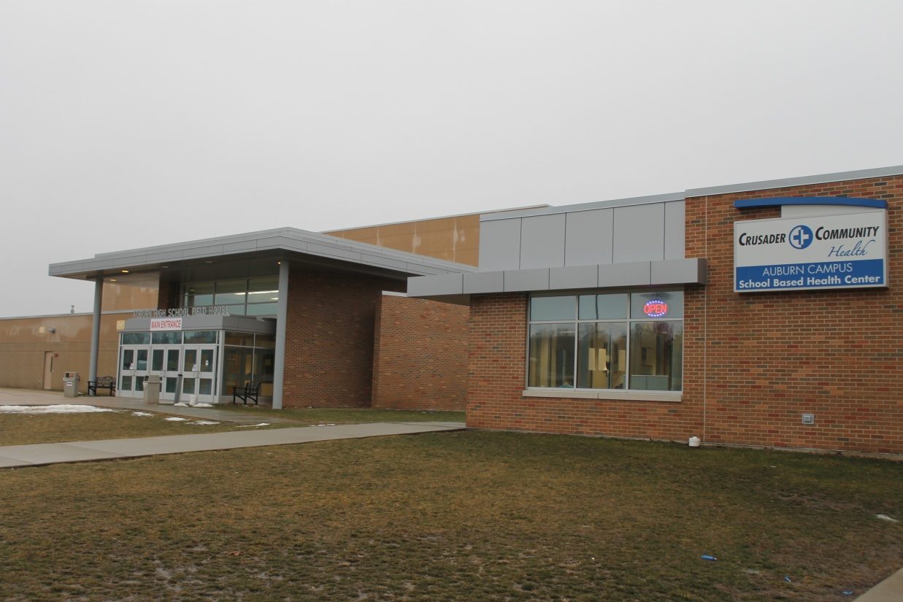
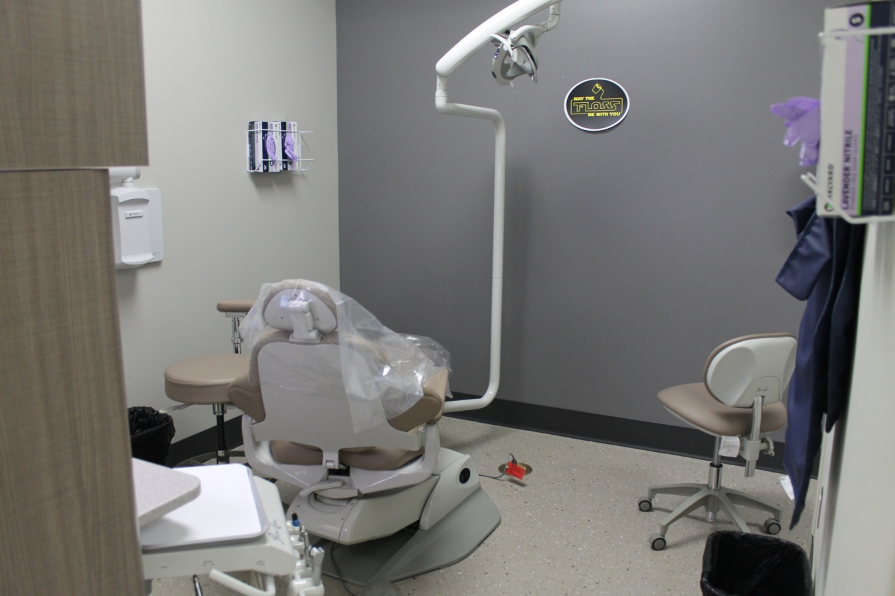
THE SBHC MODEL

Slide 11
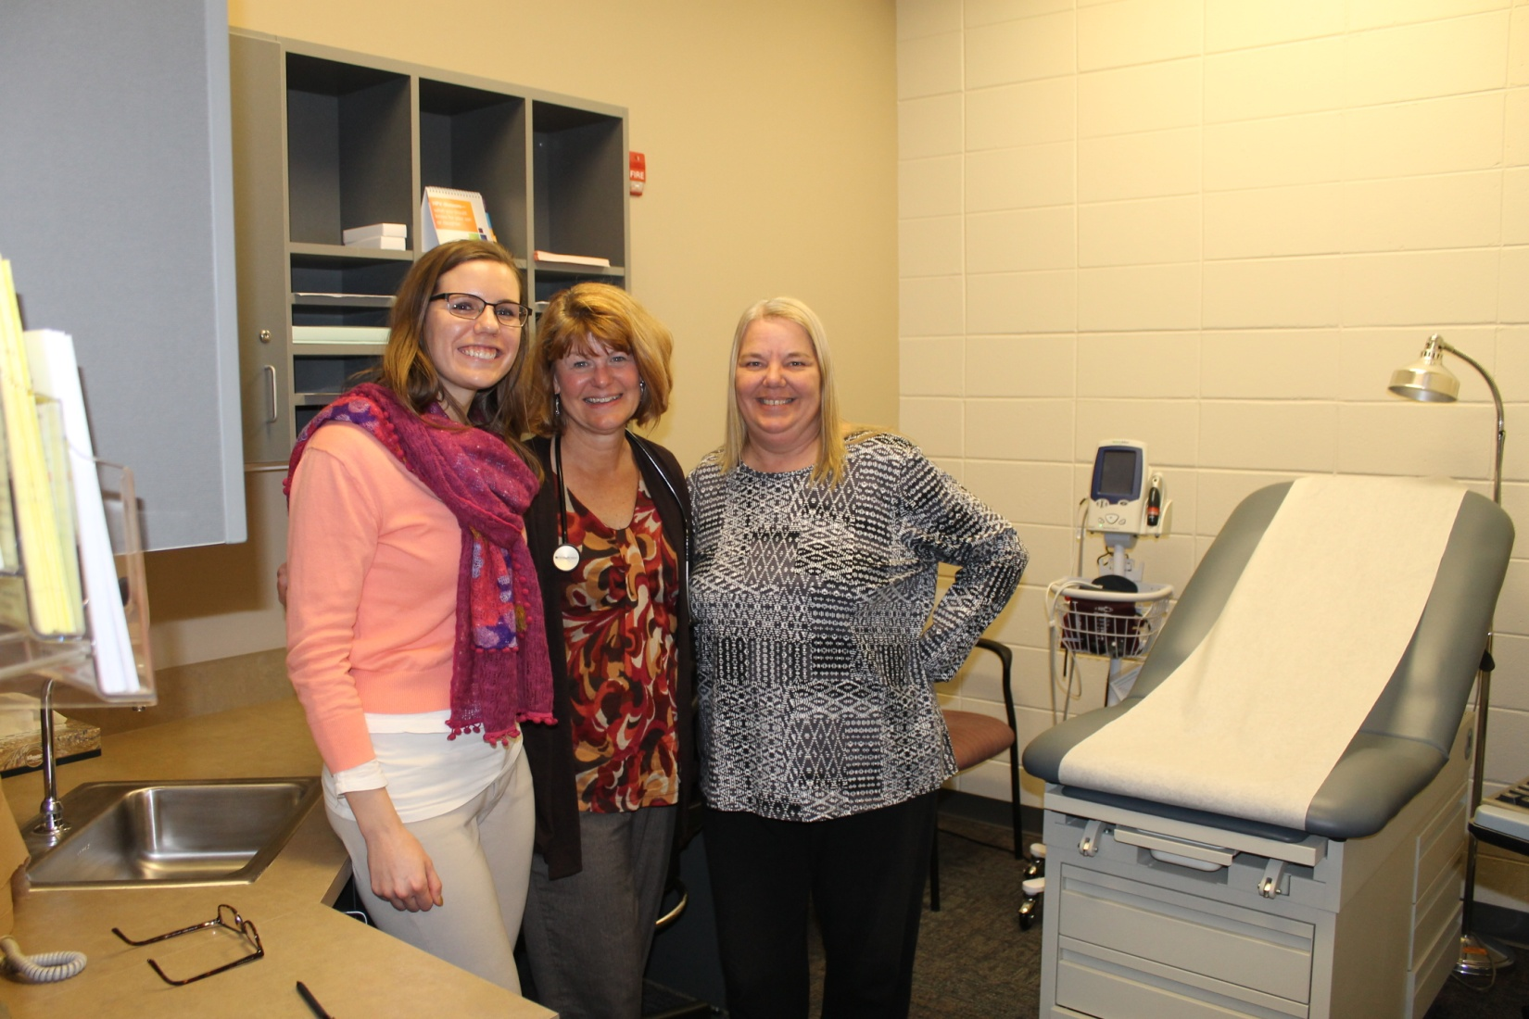
THE SBHC MODEL

Slide 12
THE SBHC MODEL
A mission-driven and evidence-based model of care that prioritizes:
Serving low-income and underserved populations
Establishing comfortable, youth friendly environments
Elimination of access barriers
Serving the whole child
Wellness and prevention
School and life success
“The SBHC BH provider worked with a homeless student who was new to the school. The student struggled with depression and suicidal ideation. She continued ongoing therapy and graduated on time with her class despite her housing instability. She will be attending a state school in the fall.”

Slide 13
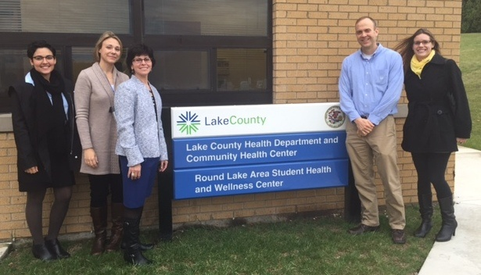
THE SBHC MODEL
Organizational Structure:
Partnership between school, medical provider, and community
Sponsoring agency: FQHC/RHC, Hospital, County Health Department, University, School District
Staffing Model:
Administrator
Medical Director
Nurse Practitioner or Advanced Practice Nurse
Licensed behavioral health provider
Medical assistant
Front-desk/Administrative support
Dentist
Health educator
Nutritionist

Slide 14
A DAY IN THE LIFE OF
A SBHC
Monday, October 10, 2017: 9:00a.m.-12:00p.m.
Yolanda, 17 year-old …………… Sore throat
Emilio, 16 year-old……………… ADD/ADHD
Pheng, 19 year-old……………… Immunization
Keesha, 16 year-old…………….. No show
Willie, 15 year-old……………….. Sports Physical
Carmen, 14 year-old…………….. Asthma
Tanya, 14 year-old……………….. Depression
Cassandra, 17 year-old…………. Birth Control
Alex, 15 year-old ………………… Acne
Neng, 14 year-old………………… Sprained ankle
Julie, 15 year-old ………………… Abdominal pain

Slide 15
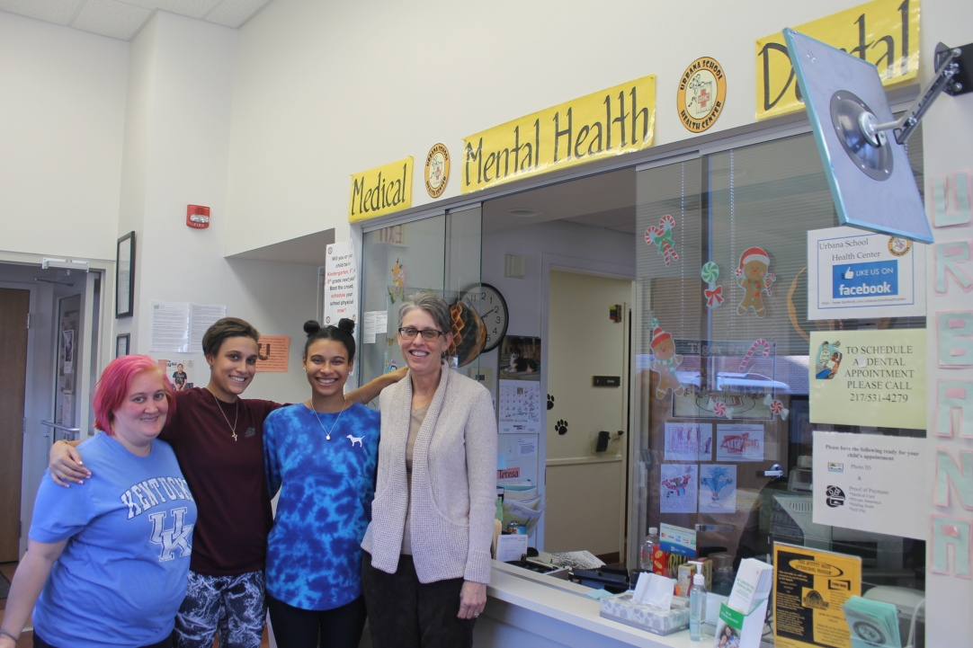
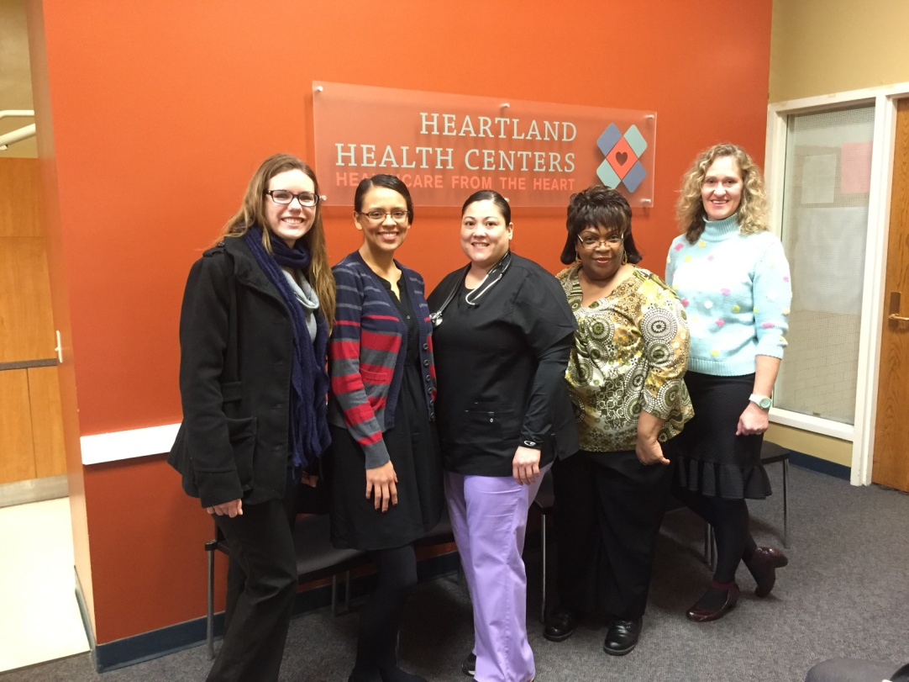

Slide 16
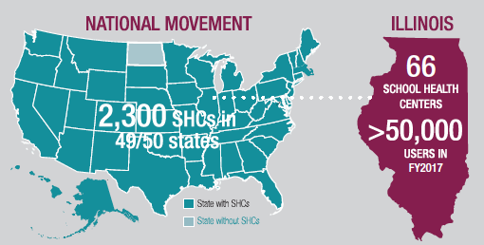
SBHCs IN ILLINOIS

Slide 17
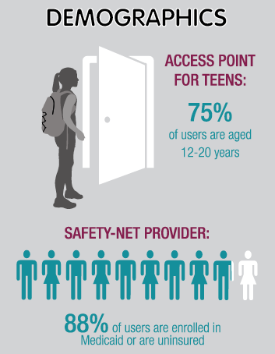
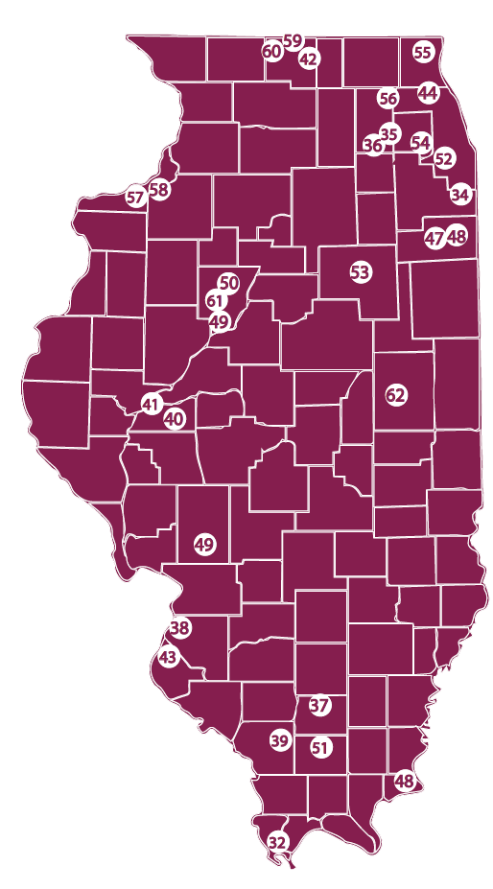
SBHCs IN ILLINOIS

Slide 18
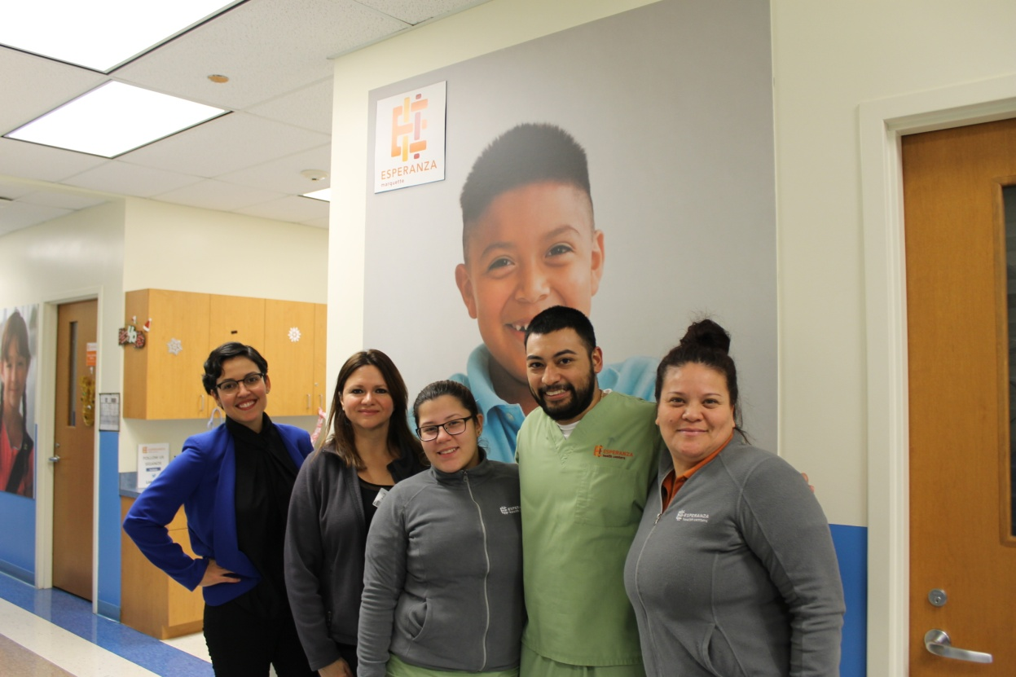
SBHCs IN ILLINOIS
Predicated on partnerships
Medical sponsor
School
Other MOUs
Community
Funding
Government grants
Private grants
Billing
Quality
Administrative code and certification
Accreditations
Quality improvement

Slide 19
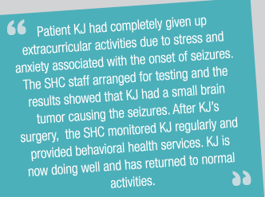
BEHAVIORAL HEALTH SERVICES IN SBHCs
90% of IL SBHCs provide BH services on-site
Employ LCSWs and LCPCs directly
Contract with community-based providers
Combination
Integrated behavioral health services
SBHCs are leading trauma-informed practices in their centers and schools
Training opportunities
Screening projects with parents
Building community awareness
Minfdulness and self-regulation activities, secondary trauma
School-wide “mindful minute”

Slide 20
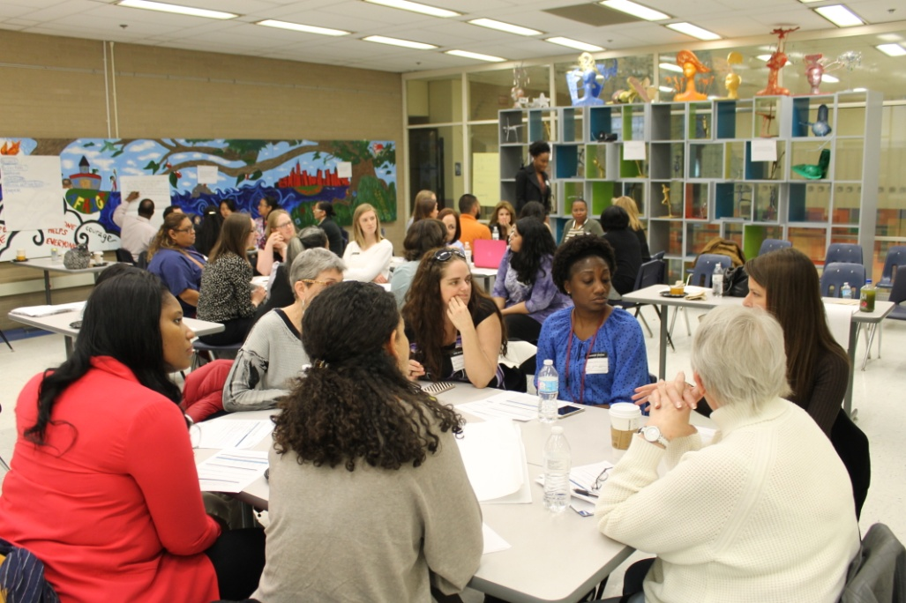
ISBHA BEHAVIORAL HEALTH INITIATIVES:
Trauma and trauma-informed care in SBHCs
Developing innovative models for behavioral health reimbursement
Advocacy
Staff morale – Empowerment Institute
Sharing best practices
Forging partnerships for the field

Slide 21
PARTNER WITH US!
Follow-up meeting or presentation
Maps, listings
Newsletter
Connections to SBHCs in your service area
Brainstorming opportunities

Slide 22
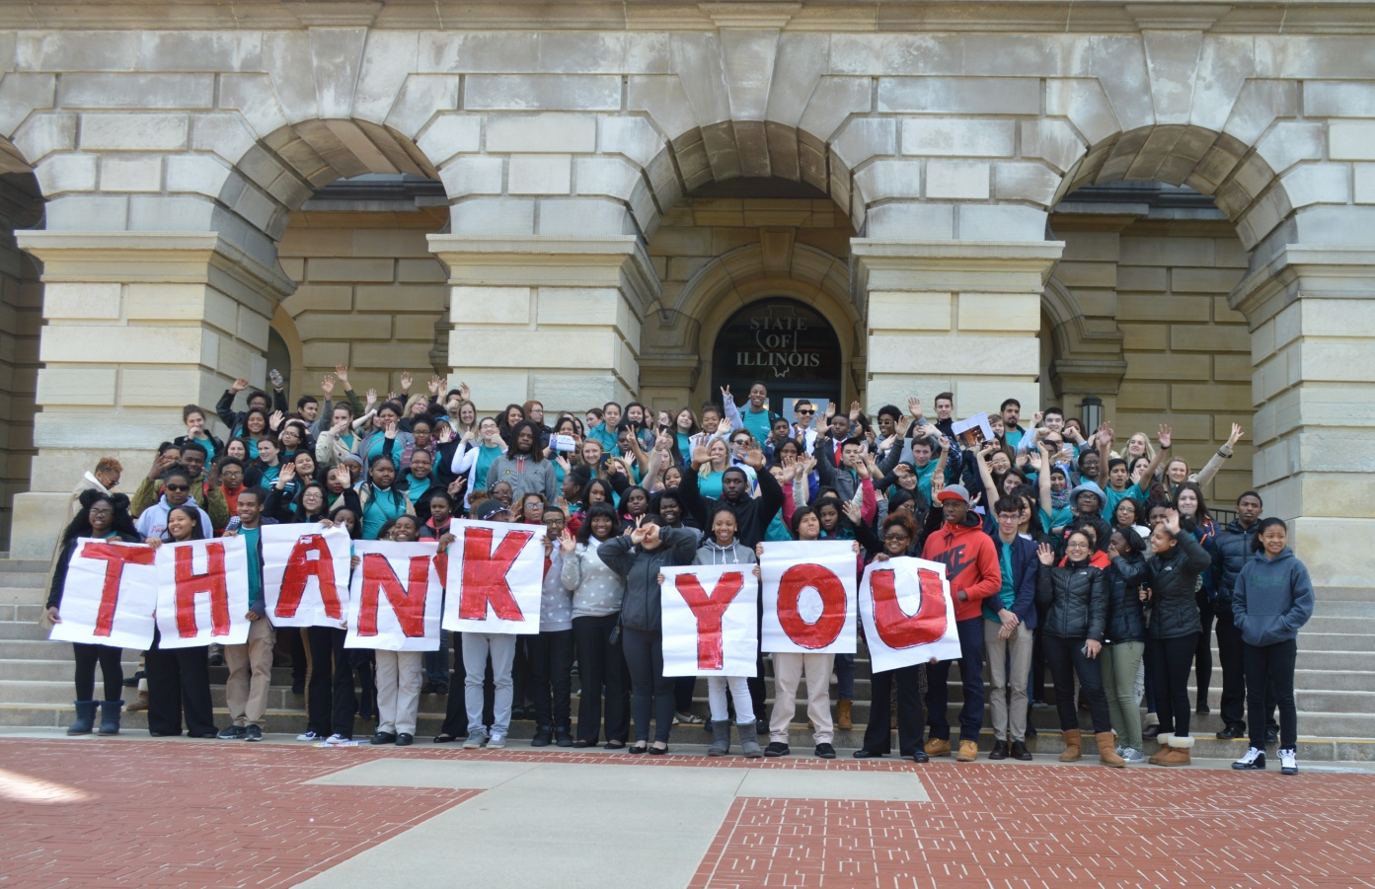
THANK YOU!
Heidi Ortolaza-Alvear, AM, MPP
Director, Child and Adolescent Health Initiative
Email: hortolaza-alvear@everthriveil.org
Visit our website at www.everthriveil.org
Find us on Twitter @EverThriveIL
Like us on Facebook at facebook.com/EverThriveIL

