Slide 1
Are You Embracing Change or Running Away from It?
Illinois
December 12, 2017

Slide 2
My Background
Medical Director for National Council for Behavioral Health
Previously
  Missouri Medicaid Director – 3 years
  DMH Medical Director – 20 years
Practicing Psychiatrist
Distinguished Professor, Missouri Institute of Mental Health, University of Missouri –St. Louis
Adjunct Professor of Psychiatry – University of Missouri Columbia

Slide 3
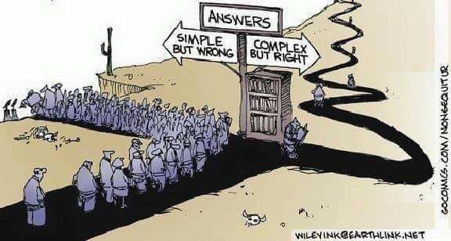
Choose Your Future

Slide 4
Drivers of Increased Demand for Behavioral Health Care
ACA Insurance reforms and Medicaid expansion substantially increases behavioral health coverage for adults
ACA requires newly covered populations meet the parity requirements of Wellstone Domenici Parity Act
Multiple parts of ACA require or incentivize integration of Behavioral Health and general medical care
Stigma continues to drop releasing pent up demand
In responding to recent press coverage of mass shootings increasing mental health services is more popular than gun control

Slide 5
New Drivers of BH Demand
Medicaid Access Rule
  Went into effect October 2016
  Requires that MHD monitor and report on Access to 5 essential provider types – one is BH
Medicaid Managed Care Rule
  Extends Wellstone-Domenici BH parity to Medicaid Managed Care
  Requires very detailed parity analysis for every eligibility group/benefit plan – approx. 100 in MO!
Medicare MACRA P4P

Slide 6
Per Member Per Month Costs
Melek et al Milliman, Inc. 2013

Slide 7
MH/SU costs in NY State’s Medicaid Program

Slide 8
How Are Payers Responding to Need to Control Spending?
A Focus on Improving Quality, Controlling Costs and Increasing Value
  Focus on high-need, high cost populations, including persons with chronic conditions, disabilities, in LTC and on both Medicaid and Medicare (dual eligibles)
  Quality improvement: strengthening contract requirements for health plans, pay-for-performance, special initiatives e.g., on non-emergency ER use.
  Cost savings through managed care, delivery system and payment reforms, payment restrictions.
SOURCE: Vernon Smith, et al., “Medicaid in an Era of Health & Delivery System Reform: Results from a 50-State Medicaid Budget Survey for State Fiscal Years 2014 and 2015,” Kaiser Family Foundation, October 2014.
27
Notes:
8

Slide 9
What Payers What
Lower Costs (Utilization)
Better Care (Quality)
Both only pay if
  Savings Occur
  Quality meets explicit measured results
Predictability
Integration with BH (but don’t know what that is)
Social Determinants addressed (but don’t know how to)
You (and everyone else) to Share Their Risk

Slide 10
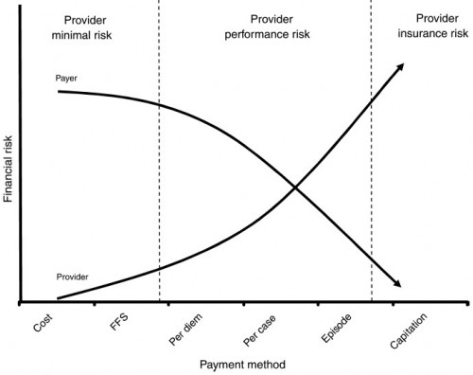
A Quick Overview of Assumption of Risk Models
Model 5
Model 4
Model 4
Model 3
Model 2
Model 1
Averill, Richard F. MS; Goldfield, Norbert I. MD; Vertrees, James C. PhD; McCullough, Elizabeth C. MS; Fuller, Richard L. MS; Eisenhandler, Jon PhD. Achieving Cost Control, Care Coordination, and Quality Improvement Through Incremental Payment System Reform. Journal of Ambulatory Care Management: January/March 2010 - Volume 33 - Issue 1 - p 2–23

Slide 11
…from encounters…to ongoing management
Fee-For-Service
Pre-Encounter
Encounter
Post-Encounter
Disengaged
X
$$$$$
X
X
Population Management
Pre-Encounter
Encounter
Post-Encounter
Disengaged
$
$$
$
$

Slide 12
BH Advantages
Higher Cost/Utilization Patients have more opportunities for improving and cost savings
More Comfortable working outside of Clinic/in Community
Ability to maintain engagement with people others don’t understand and can’t tolerate
Actually know what Social Determinates of Health are and how to impact them
Motivational Interviewing
Lower unit cost for personal interactions

Slide 13
What BH Organizations Need to Evolve and Prosper
A Role no one else wants or can do
Data, Data, and more Data
Willingness to Risk and Change
Training, Training, and more Training
Integration Partnerships with the Rest of Health Care
Keep using the Personal Relationship

Slide 14
Delivery System Redesign
Data Driven Care
Population Management
Integration of Behavioral Healthcare and general Healthcare
Increase use of Preventive care
Increase access to Primary care
Health Information Technology interoperability stds

Slide 15
Important Provider Competencies
Care Coordination
Clinical Integration
Care Management
Characteristics:
Outcomes-oriented
Enabled by technology
Patient-centered
Use of data and analytics
Performance transparency
Ability to partner across organizations
Notes:
Physicians and their role in ACOs.
For accountable care to take hold, three key interdependent aspects of transformation must occur, each interdependent upon the other, as in a three-legged stool: Care delivery reform, payment reform and health information technology infrastructure. Under care delivery reform, enabled by technology, we find
Care Coordination
Care Management
Clinical Integration of providers and care provision ( i.e. health information technology enabled)
Outcomes-oriented/evidence-based care

Slide 16
Population Health Definitions
The health of the population as measured by health status indicators and as influenced by social, economic and physical environments, personal health practices, individual capacity and coping skills, human biology, early childhood development, and health services. (Dunn and Hayes, 1999)
A conceptual framework for thinking about why some populations are healthier than others as well as the policy development, research agenda, and resource allocation that flow from it (Young 2005)

Slide 17
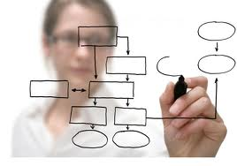
What is a Population Health Management?
Not just a Healthcare benefit
Not just a program or a team
It’s a system and an organizational transformation

Slide 18
Population-Based Care
Don't rely solely on patients to know when they need care and what care to ask for from whom - Use data analytics to outreach to on high need/high utilizer patients
Don't focus on fixing all care gaps one patient at a time - Choose selected high prevalence and highly actionable individual care gaps for intervention across the whole population
The population-based health care provider is the public health agency for their clinic population

Slide 19
Population Management
Selects those from whole population:
  Most immediate risk
  Most Actionable improvement opportunities
Aids in planning :
  Care for whole population
  New Interventions and Programs
  Early identification and Prevention
  Choosing and Targeting Health Education

Slide 20
Six Population Health Management Services
Care Management
Care Coordination
Managing Transitions of Care
Health Promotion
Individual and Family Support
Referral to Community Services

Slide 21
Comprehensive Care Management
Identification and targeting of high-risk individuals
Monitoring of health status and adherence
Identification and targeting care gaps
Individualized planning with the patient

Slide 22
Step 1 – Create Disease Registry
Get Historic diagnosis from administrative claims
Get clinical values from metabolic screening, clinical evaluation and management, care plans
Combine into EHR Disease Registry
  CMT’s PROACT
  Azara’s DRV
Online access available to all providers

Slide 23
Step 2 – Identify Care Gaps and ACT!
Compare combined disease registry data to accepted clinical quality indicators
Identify care gaps
Sort patients groups with care gaps into agency specific to-do lists
Nurse care manager helps team decide who will act
Set up indicated visits and pass on info with request to treat

Slide 24
Care Coordination
Care Coordination
Coordinating with the patients, caregivers and providers
Implementing plan of care with treatment team
Planning hospital discharge
Scheduling
Communicating with collaterals

Slide 25
Provide Information to Other Healthcare Providers
HIPAA permits sharing information for coordination of care
Nationally consent not necessary
Exceptions:
  HIV
  Substance abuse treatment – not abuse itself
  Stricter local laws

Slide 26
HIPAA Allows
Sharing PHI for Treatment is allowed without Consent
The following, when undertaken on behalf of a single consumer (not a population), are treatment activities. :
  Case management;
  Care coordination;
  Disease management;
  Health promotion; and
  Outreach programs.

Slide 27
HIPAA Allows
Treatment includes not just health care, but also “related services.”
“Related services” can include social, rehabilitative or other services associated with health care.
HHS believes disclosures for treatment purposes are appropriate for timely and quality treatment.

Slide 28
HIPAA Allows
Individuals have the right to request restrictions on how a covered entity will use and disclose PHI about them for treatment, health care operations, and payment.
A covered entity is not required to agree to an individual’s request for restriction, but is bound by any restrictions to which it agrees.
(45 CFR 164.522(a))

Slide 29
Data-Driven Care
Patient Registries
Risk Stratification
Predictive Analytics
Performance Benchmarking
Data Sharing

Slide 30
Why Share Data
What gets measured gets done

Slide 31
Principles
Use the data you have before collecting more
Show as much data as you can to as many partners as you can as often as you can
  Sunshine improves data quality
  They may use it to make better decisions
  It’s better to debate data than speculative anecdotes
When showing data, ask partners what they think it means
Treat all criticisms that results are inaccurate or misleading as testable hypotheses

Slide 32

More Principles
Tell your data people that you want the quick easy data runs first. Getting 80% of your request in one week is better than 100% in six weeks
Treat all data runs as initial rough results
Important questions should use more than one analytic approach
Several medium data analytic vendors/sources is better than one big one
Transparent benchmarking improves attention and increases involvement

Slide 33
Types of Bundled Payment
Case Rate
Diagnostic Related Groups (a type of case rate)
Episode of Care
Prospective payment
Capitation
May or May Not Include
  Performance bonus or penalty
  Shared Savings

Slide 34
Issue – What is the Baseline?
Options
  Same patients Pre/Post
  Compared to a control group
  How long is the base period
What Services/Costs are In/Out?
On Performance Measures
  What/whose data is used
  What diagnosis, persons, procedures are excluded?

Slide 35
New Costs to Cover
Software for Disease Registry/Care Management
Data field mapping from your EMR
Data analyst/Report Developer
Data Entry
Cost Reporting/Accounting
Primary Care Expertise
Training, Training, TRAINING!!!

Slide 36
Key Principle #1 – Keep It Simple
For any individual choice point always choose the simplest solution.
Your health home project will end up really complicated in the end anyway, why make it more so?
You will almost certainly redesign your health home program after two years. You can address some of the finer points that you worry about then.
Perfect is the enemy of good

Slide 37
Most Important Principle
Perfect is the enemy of good - Error on the side of Action
Move opportunistically - it is easier to influence the direction of momentum than to create momentum
Focus on continuous incremental change - big sweeping change scares people
If you try to figure out a comprehensive plan first you will never get started
Apologizing for a failed prompt attempt is better than apologizing for missed opportunity

Slide 38


Slide 39
Putting It All Together
Data identify treatment and prevention opportunities
Training implements new evidence-based interventions
Personal interaction is the true change agent
Data analytics identify the dose response curve of personal interaction required
Training allows use of a lower-cost FTE to produce an effective personal interaction

Slide 40
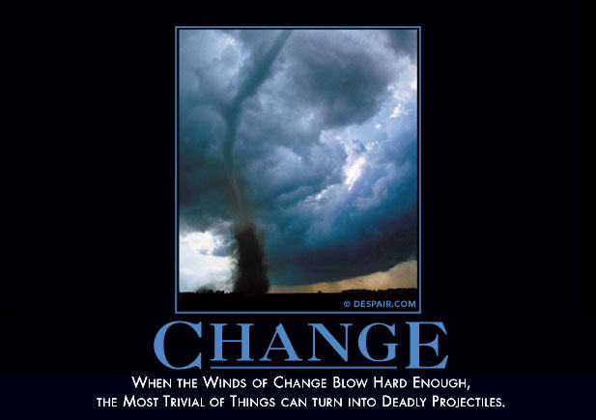

Slide 41
What BH Needs to Succeed
Get Realistic about HIPAA and 42CFR part 2
Learn to use data to manage
Keep using the Personal Relationship
Learn about chronic disease and Medical Care
Be Culturally Competent (with the rest of Health care Providers)
Act like competent confident experts
Lead by Partnership

Slide 42
Missouri Strategy
Share data relentlessly and use it to make decisions
Standardized to the extent possible - you can't use benchmarking to improve things that are not standardized
Push forward with measurement driven care
Integrate and treat the whole person
Increase clinical expertise - both credential mix and individual skills
Embrace risk and discomfort as signs of progress

Slide 43
Health Home Outcomes
Lower Blood pressure, Cholesterol, and better Blood Glucose control
Better Medication adherence
Lower ER and Hospital utilization
Healthier Lifestyles – less smoking, more active,
Saved $59.1 Million
Better working relationships between Healthcare Providers

Slide 44
A1C Levels Over Time
1 point drop in A1c
21% ↓ in diabetes related deaths
14% ↓ in heart attack
31% ↓ in microvascular complications
About 7% had uncontrolled A1c levels

Slide 45
LDL Levels Over Time
10% drop in LDL level
30% ↓ in cardiovascular disease
About 45% had uncontrolled LDL levels

Slide 46
Blood Pressure
Changes Over Time
6 point drop in Blood PRESSURE
16% ↓ in CD
42% ↓ in stroke
20-24% had uncontrolled BP levels

Slide 47

What Makes it Possible?
A Relationship of basic trust between:
  Department of Mental Health
  MO HealthNet (Medicaid)
  State Budget Office
  MO Coalition of CMHCs
  MO Primary Care Association
Transparent use of data instead of anecdotes to explore and discuss issues
Willingness of all partners to tolerate and share risk
Principled negotiation and Motivational Interviewing

Slide 48


Slide 49

Partner for Success:
Build a Neighborhood

Slide 50
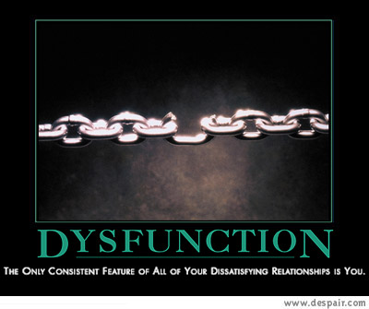

Slide 51
Partnership Principles
DO
Ask about their needs first
Give something
Assist wherever you can
Make it about the next 10
Pursue common interest
Reveal anything helpful
Take one for the team
DON’T
Talk about your need first
Expect to get something
Limit assistance to a project
Make it about this deal
Push a specific position
Withhold information
Let them take their lumps

Slide 52

S.M.R. Covey, The Speed of Trust
Behaviors that Promote Trust
Character
  Talk Straight
  Demonstrate Respect
  Create Transparency
  Right Wrongs
  Show Loyalty
Competence
  Deliver Results
  Get Better
  Confront Reality
  Clarify Expectations
  Practice Accountability
Character & Competence
  Listen First
  Keep Commitments
  Extend Trust

Slide 53
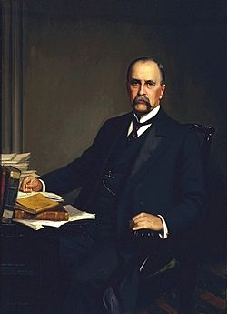
Switch: Patient to Partner and Disease to Project
It is more important to know what manner of patient who has the disease, than to know what manner of disease the patient has.
Sir William Osler
Notes:
Thank you Jack and Carol for reminding us that
the reduction of opioid use must be done within the context of attending to and treating pain appropriately
Osler reminds us that knowing our client is essential
And without knowing the client we don’t have the tools to effectively treat their pain
For those of you who work in the community mental health system,
Our first step is recognizing the complex and profound relationship between pain/anxiety/ and depression.
Pain can be a common symptom—and sometimes a good indicators—of an anxiety disorder
Depression magnifies pain, making it more difficult to cope with everyday living
On average over 65% of depressed individuals complain of pain
Overlap of anxiety, depression, and pain is particularly evident in chronic pain such as fibromyalgia, IBS, low back pain, and nerve pain.
About 2/3rds of patients with IBS who are referred for follow-up care have symptoms of psychological distress, most often anxiety.
We’ve learned more about the relationship of pain, anxiety, and depression…….not only the psychological but biological factors that contribute to the complex relationship.
Treatment is challenging when pain overlaps with anxiety or depression.
Focus on pain can mask both the clinician’s and client’s awareness that a psychiatric disorder is also present.
Even when both types of problems are correctly diagnosed, they can be difficult to treat.
As we were preparing for this I reflected on my years as Commissioner of Mental Health a decade ago when we were just beginning to take a deep dive in to the relationship with mental and physical illnesses…..and searching for the early models of integrated care.
Yet the understanding of this complex relationship of anxiety/depression/pain or how to treat it was not in our nomenclature.
I recently attended a conference on Pain Management and when I returned I had several conversations with clinicians at a variety of mental health centers in my State of Illinois. The first was a former student of mine who was doing her internship at a rural mental health center who was telling me about the caseload she had been assigned. An obese man with unremitting depression, who most of the other clinical staff felt hopeless to effect change. He was on a boatload of meds, had no job, few friends, no work or recreational activities, slept most of the time, ate….thought of suicide. As we dug deeper into the conversation, my former student shared that she had discovered that this cycle started multiple years ago when her client suffered a back injury…..and that the boatload of meds included meds to relieve his pain. The treatment plan did not address his pain as key in his treatment of depression.
Further conversations with wonderful clinicians at other mental health centers, revealed similar stories. One of the clinical supervisors told me that she felt bad about sharing this, but when someone asks her for pain medication she
automatically assumes this is a case of self medicating……and rarely do they look at possible pain involvement.
Next slide

Slide 54
Partnership Strategies
Systematically discuss that the long term relationship is more important than the current project
Seek to build mutual dependency and vulnerability. Automatous invulnerable organizations usually behave badly
Hire each others middle managers whenever the opportunity arises

Slide 55

Partnership Mentor - Dancing
You have to know your partners location, center of gravity, and velocity before doing anything
It's about opening doors and getting out of the way, not by pushing or pulling in a particular direction
Successful motion is about where your center goes not what happens with your extremities (demonstration projects are a waste of time)

Slide 56
Partnership Mentor - Dancing
Communicating clear and consistent intentionality is essential
You have to lead at the level that your partner is able to follow
Really skilled partners switch off who leads and who follows
If your partner doesn't look good it's your fault
Always thank your partner no matter how well or poorly things went

Slide 57
My Leadership Mentors
The Boy Scouts
  Often the most effective way to lead is being the first one to very publicly follow someone else's direction
  Make it fun
Keith Schafer - Keep communications clear and simple. A single page that your aunt or store clerk could read and understand.
Dorn Schuffman - Character makes it happen both for individuals and organizations
“Getting to Yes – Principled Negotiation” - by Fisher and Ury

Slide 58
Leadership Mentor - Pharma
Repeat your message relentlessly
Segment your audience and tailor your leadership message for each audience - everyone doesn't respond to the same images and motivations
Communicate a lot more about the successes than the shortcomings
Small gifts help a lot
Sometimes reality is a group consensual delusion - if you can get everybody to agree that something is so, then it becomes so

Slide 59
What We Learned
Organizational culture and professional culture are really important
Error on the side of Action
Effective Leaders Are Unrealistically Optimistic
Most people are surprisingly hungry to get some good leadership - and ready to follow
Consistent immediate responsiveness increases your influence and power
Rituals are important and powerful

Slide 60
What We Learned
Focus on continuous incremental change - big sweeping change scares people
Strategy is about a broad a general direction and not a detailed roadmap
Move opportunistically - it is easier to influence the direction of momentum than to create momentum
Reserve time to get to know of obstensibly unrelated organizations and industry sectors - you will discover resources and opportunities that you never knew existed

Slide 61
Trust and Collaboration
Trust promotes collaboration
Collaboration promotes trust
Trust and collaboration promotes common problem solving and system successes
Trust and collaboration decrease parochialism
Parochialism is the seed of failure

Slide 62


Slide 63
Questions?
Joseph Parks, M.D.
Medical Director
National Council for Behavioral Health
JoeP@thenationalcouncil.org

