Slide 1
Moving Toward Value-Based Payments
For Medicaid Behavioral Health Service
Forging New Paths in a Value Based Landscape
Community Behavioral Health Association
Annual Conference 2017
Hyatt Regency Schaumburg | December 11 & 12, 2017

Slide 2
Agenda
Challenges Facing Behavioral Health Providers
Case Studies
Overview of Centerstone
Discussion/Questions
Preparing for Value Based Payments
Notes:
I hope with the information I provide to you today can help you navigate the very confusing world of managed care.
I want our discussion today to be interactive. Please feel free to stop me if I get use too much jargon or you want to ask a question.
[Go through agenda here]

Slide 3
About Centerstone

Slide 4
Noble purpose
Delivering Care that Changes People’s Lives
Notes:
Working in Payer Contracting I don’t often, hardly ever in fact interact with patients/clients. I read language, I look at financial analysis, I negotiate rates. I’ve always known intrinsically that my work helps clients get access to care but its almost been an abstract thought. However when I came to Centerstone it’s not abstract. It is real and we talk about often. We start every meeting with a Noble Purpose moment. We are challenged to connect the dots, especially if we are not in a patient/client care area. Working for Centerstone has changed the way I approach my job as a non-clinician.

Slide 5
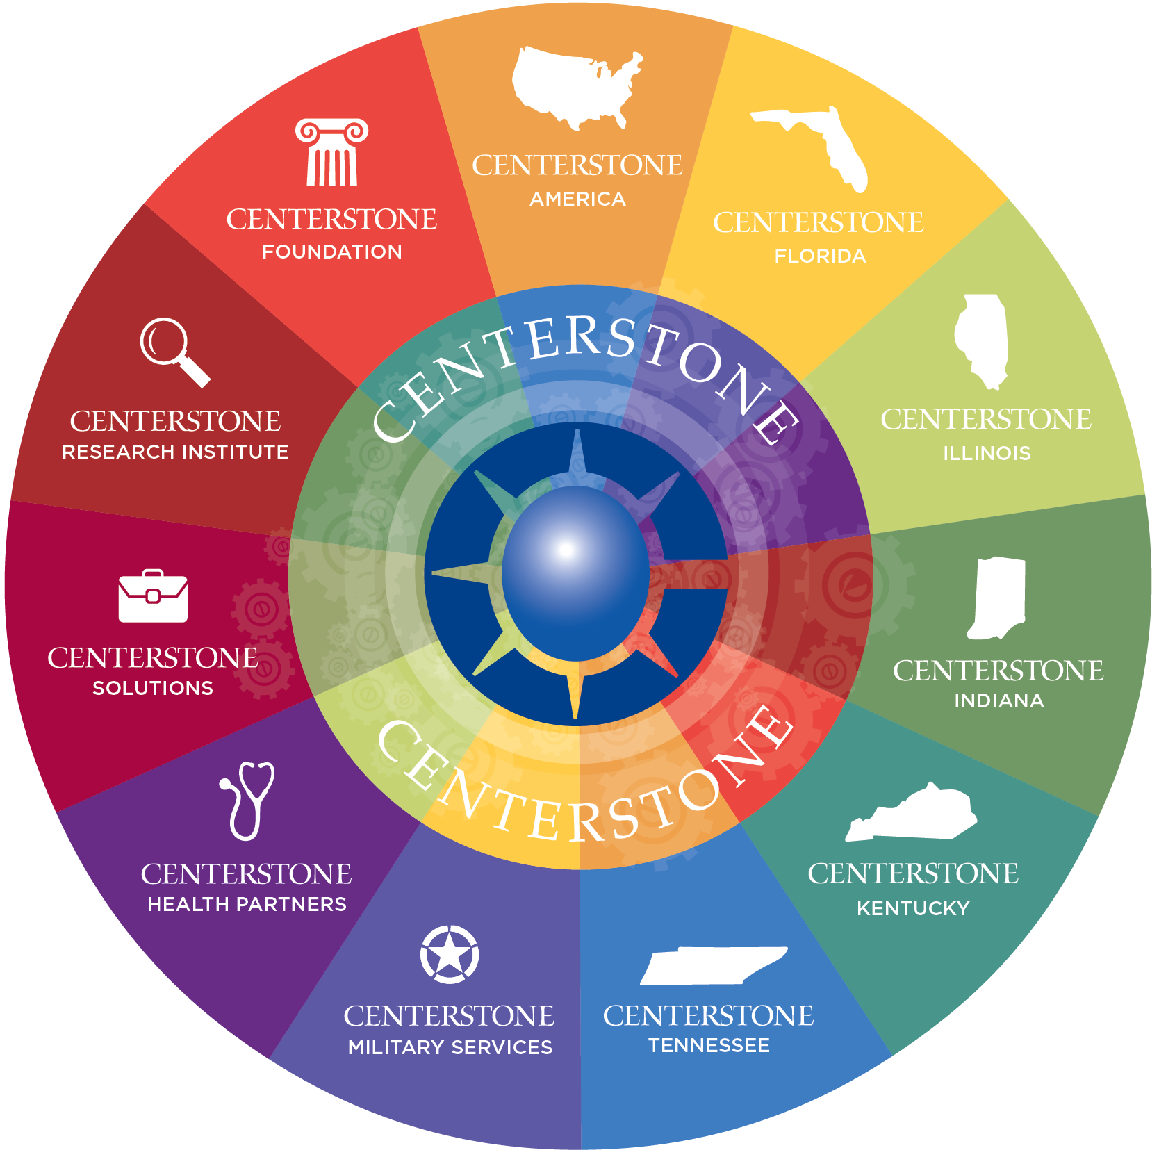
CENTERSTONE at a Glance
Delivering care that changes people’s lives
Bringing Science to Service
Recognized national behavioral health leader, private, not-for-profit 501(c)(3) healthcare organization
60+ years in operation
Specializing in the treatment and rehabilitation of individuals with mental illness, addictions, traumas, and intellectual/developmental disabilities
Five state primary footprint; specialized services spanning all 50 states
CARF and Joint Commission Accredited
Including specialized CARF Accreditation – Adult and Children & Youth Health Home
Notes:
We are an organization that’s been around for nearly 60 years. In the 7 years we have affiliated and grown to the size we are today. Currently we have about 200 locations in 5 states and service clients needing treatment in mental illness, addictions, traumas, and intellectual/developmental disabilities

Slide 6
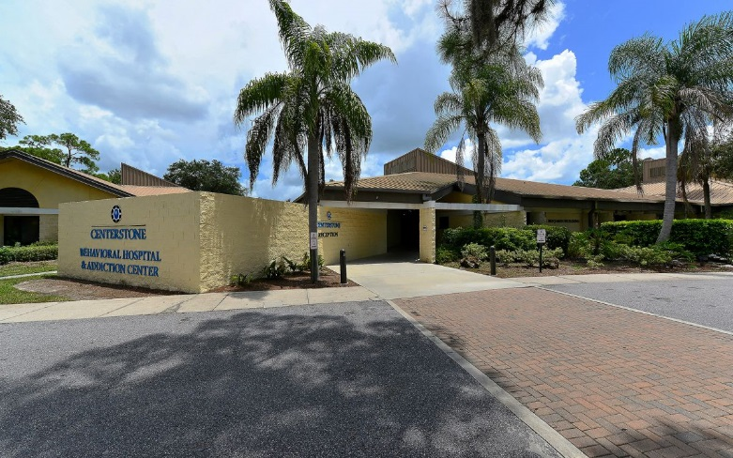
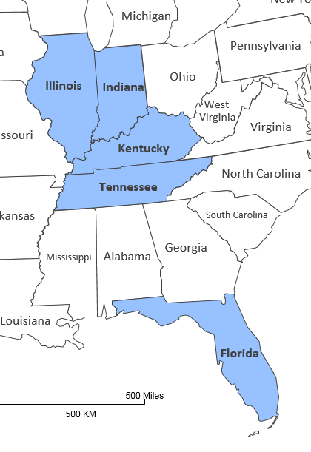
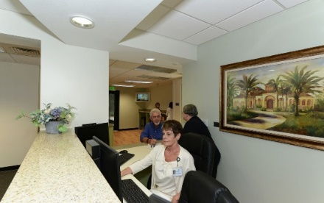
Centerstone’s Reach
In FY 2016
People Served
172,000+
49%-Male
51%-Female
All ages served
Services Provided
2,781,000+
Staff
5,000+ clinical and administrative staff and a national network of over 700 contract therapists.
Signature Service Lines
Health Homes
Integrated Primary Care
MAT/Addiction Services
Hospital and Crisis Services
Active Military and Veterans
Intellectual and Developmental Disabilities

Slide 7
Challenges Facing Behavioral Health Providers
Making the Leap to VPB

Slide 8
VBP Challenges facing Behavioral Health
Dual Payment Environment
Limited quality measures specific to behavioral health.
Wide variety of value based payment opportunities
Documentation of Services Provided
Cost Transparency
Lack of general managed care exposure or experience
Infrastructure and IT Costs to Shift to VBP

Slide 9
Revenue Tug of War
Fee for Service
Revenue gains based on volume
Payer
Provider
Member/Client
tug of war noun
noun: tug of war; plural noun: tugs of war
a contest in which two teams pull at opposite ends of a rope until one drags the other over a central line.

Slide 10
Dual Payment Environment - Converting to value based Payments

Slide 11
Value Based Contracts
Pay for Performance
Bundled Payments
Sub-Capitation
Not all Value Based Contracts are created equal
If you’ve seen one value based contract you’ve seen one.
Notes:
The need for sophisticated billing and how they could beef it up.

Slide 12
Value Based Purchasing We can’t Show Value without Knowing Our Costs
Knowing cost is a critical piece of being able enter into value based agreements.
Understanding what is embedded in those costs and services provided
Stratifying risk to understand what the contract means
Revenue Predictability Models – Its not apples to apples.

Slide 13
Data Driven Strategy
Better Data, Better Care
Data will inform our decisions and strategy for value based care.
Data provides insight on performance, costs, readmission rates and patient outcomes.
Data needs to be meaningful, actionable and valuable.
Moving from reactive to proactive based on analytics
Build data models that predict and optimize business outcomes.
Develop business relevant analytics that can be put to use.

Slide 14
Value Based Payment Readiness
Is your organization ready for value based payments?
Do you know how much it costs to deliver care?
All areas of your organization must have a seat at the table to be successful.
Develop a readiness assessment to evaluate current state and future state capabilities.
Identify and prioritize financial and operational gaps.
Practice Transformation Steering Committee bringing key stakeholders to the table.
Financial Sustainability
Organizational Readiness
IT Capabilities
Care Delivery
Payer Partnerships
Cost Analysis

Slide 15
Adapting to Change
It is not the strongest of the species that survives, nor the most intelligent. It is the one that is the most adaptable to change. Charles Darwin

Slide 16
Preparing for Value Based Payments

Slide 17
It’s A maze out there

Slide 18
A Winding path To Value Based Payments
Don’t be tied to the Process
Be Tied to the Goal
Behavioral Health is in the middle of a huge transformation leading toward improved outcomes and cost reduction.
Organizations will have to adapt and change to get there. Be tied to the goal.
Data, Flexibility & Payer Relationships are keys to finding solutions.

Slide 19
Working together – Collaborative Interface
Marketing
Relationships
Communication
Clinical
Rates & Analytics
Payment Strategies
Partnerships for Success
Language/ Contract Review
Evidence Based Clinical Models
Bringing Science to Service
Understanding Health Plan Goals
Payer Contracting
Health Plan
Outcomes
Payment Innovation
Cost Savings

Slide 20
Organizational Alignment
Population Health & Integrated Care
Evidenced Based Clinical Models
Connected Electronic Health Records
Focus on Value, Experience & Outcomes
Financial Metrics & Analytics
Value Based Contracting
Data Driven Analytics

Slide 21
Partnership for success
Be Creative In Your Approach – Be Open to Pilots
Provide Peer and/or family support models
Create Centers of Excellence
Enhance Infrastructure around EMR & Data Analytics
Submit Claims Electronically

Slide 22
Centerstone’s Approach to VBP
Develop Strong Relationships
Set Priorities based on data & analytics
Stay abreast of trends, legislation and the overall competitive landscape
Look for opportunities
Know your payer partner
Know your value proposition
Develop your proposal
Be Patient
Stay connected to your internal teams – make sure your organization is ready
Develop Proposal
Set Priorities
Develop Relationships
Know Your Market
Organizational Readiness
Notes:
Begin developing relationships
Set Priorities based on data & analytics
Stay abreast of trends, legislation and what other providers are doing with payers.
Look for opportunities
Know your payer partner.
Know your value proposition
Develop your proposal
Be Patient – It’s Health Plan Time
Stay connected to your internal teams – make sure your organizations are ready

Slide 23
The New Normal
To be successful, Behavioral Health leaders will need to jump head first in the water, examine the possibilities and lead their organization through the change.
Convert learning into actionable change and new service opportunities
Behavioral Health Organizations will experience more change in the next few years than the last half century.

Slide 24
Things Never Go As Planned
What I Planned.
What Actually Happened.
“Innovation is Messy. It’s about constructive conflict – not agreement. There are twists and turns – no straight lines.” Jeff DeGraff

Slide 25
Case Studies

Slide 26
Case Study No. 1
IPAs are physician owned and are at full risk
PCPs are overwhelmed with behavioral patients and don’t have the understanding or time to manage their needs beyond med management.
Currently contracted FFS
Single phone number with reporting on follow-up.
Large, national payer with regionally focused IPAs.
Scenario:
Goals:
Creating a central point of access and process for PCPs to refer much like they would to any other specialist.
Provide a solution for PCPS who’s patients need more than medication management.
Move to a shared savings contract once we have data to support outcomes and cost savings.
Create additional revenue through existing contract by increasing referrals directly to Centerstone.
Current Status:
The pilot kicked off Nov. 1stand thus far it is going extremely well.

Slide 27
Case Study No. 2
Scenario
Goals
Large national payer with individual health plans in each state.
Payer is working on establishing value based payment structure through pilots.
Government programs only, no commercial business.
State is rebidding all Medicaid business
Currently participating provider
Contract with the payer as an integrated health home.
Begin with a bundled or enhanced rate for members either assigned or referred.
Current Status
Pilot executed November 1st.
Expanding reach of value based payment contract.
Good experience working through kinks.
Very small pilot but it helps Centerstone & the payer work out systems around VBP.

Slide 28
Case Study No. 3
Scenario
Current Status
Very large payer representing the largest book of revenue in the state.
Long term bundled rate with expectations not being met.
Poor relationship with both sides at odds with the other.
At one point a term was issued with no notice required.
Three months into a new contract with tiered shared savings reimbursement.
Several months of relationship management to both internal and external stakeholders.
A 90-Day extension was negotiated.
Reporting period on upcoming round of data.
Technology and data tracking issues are being resolved.
Relationship management continuing.
Goal
Improved outcomes, cost savings and improved data reporting.
Continued improvement on relationship.
Positive outcomes on and shared savings realized.

Slide 29
Case Study No. 4
Scenario
Current Status
National payer, state based program.
First year in the program and we have realized some financial share savings.
Goal
Improved outcomes, cost savings and improved data reporting.
Reduced ER Admissions
Positive outcomes on and shared savings realized.
Behavioral Health Quality Improvement Program.
Incentives based on hitting metrics
Upside only but new program to the staff of this state.
Reduced Impatient Admissions
Metrics around data reporting through documentation.
Identified opportunities for additional gains through improved documentation and reporting of services provided.
Internal staff education ongoing to ensure we are capturing all possible revenue opportunities.
Great payer relationship and ongoing

Slide 30
Discussion/Questions

Slide 31
Contact Information
Dawn S. Kingsley, MSHA
Vice President, Payer Contracting & Strategy
Centerstone America, Inc.
44 Vantage Way, Suite 400
Nashville, TN 37228
Phone: 615-463-6646
Email: dawn.Kingsley@Centerstone.org
www.Centerstone.org

