Slide 1
State Innovations in Value-Based Payment for Behavioral Health
Rachael Matulis, Senior Program Officer
Community Behavioral Healthcare Association Of Illinois
December 11, 2017
© 2017 Center for Health Care Strategies

Slide 2

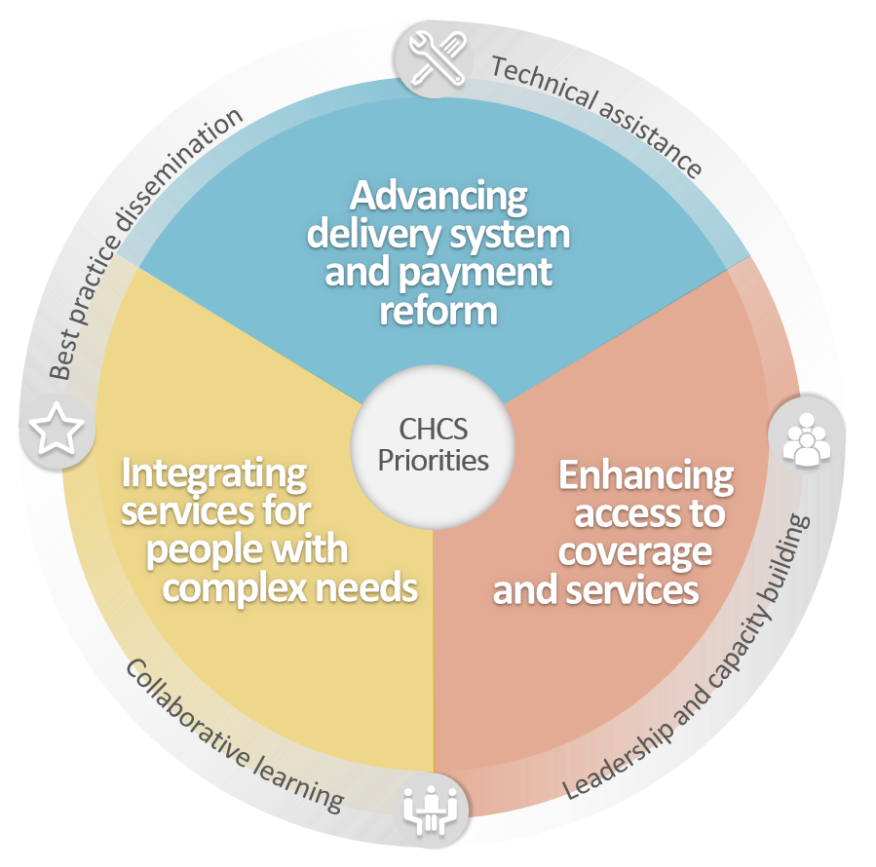
About the
Center for Health Care Strategies
Non-profit policy center dedicated to improving the health of low-income Americans

Slide 3
Agenda
Basics of VBP in Behavioral Health
Overview of State Approaches to VBP in Behavioral Health
Challenges and Best Practices for VBP in Behavioral Health

Slide 4
Basics of VBP in Behavioral Health

Slide 5
Exhibit 1. Health Care Spending as a Percentage of GDP, 1980–2013
Why Value Based Care?
* 2012.
Notes: GDP refers to gross domestic product. Dutch and Swiss data are for current spending only, and exclude spending on capital formation of health care providers.
Source: OECD Health Data 2015.

Slide 6
Alternative Payment Model (APM) Framework
Goal is to shift U.S. health care system toward payment models in Categories 3 and 4. In 2016, ≈18% of Medicaid payments fell in these categories.
Category 4:
Category 3:
Population-based payment
(e.g. global payments)
Category 2:
Level of financial risk
Alternative payment models built on fee-for-service payment
(e.g., shared savings/risk)
Category 1:
Fee-for-service payments linked to quality/value
(e.g., pay-for-performance)
Fee-for-service payments not link to quality/value
(e.g., traditional FFS, DRGs)
Degree of care, provider integration, and accountability
Source: Health Care Payment Learning & Action Network (LAN) APM Framework, available at: https://hcp-lan.org/workproducts/apm-whitepaper.pdf

Slide 7
VBP Approaches Can Vary Based on State BH Service Delivery Model
SOURCE: Internal CHCS analyses. Note: Focus on specialty mental health services; Includes District of Columbia. Includes announced reforms as of September 2017.

Slide 8

Current Landscape of Behavioral Health Quality Measurement
Fewer nationally endorsed quality measures for behavioral health than physical health
Commonly used BH quality measures: 7-day FUH after MH hospitalization and screening for depression
Use of phased-in measurement before providers assume more accountability for quality and costs
  Infrastructure measures (e.g., achieving behavioral health home certification, implementing EHR)
  Pay for reporting (e.g., collecting patient-level information on depression screenings)
  Use of process measures (e.g., follow-up after hospitalization for mental illness, antidepressant medication management)

Slide 9

Looking Forward on Behavioral Health Quality Measurement
Progress is being made in expanding BH measures that could be used for VBP
Substance use
  In January 2017, NQF endorsed three quality measures related to opioid overuse
Recovery-oriented measures
  NCQA developing a broad goal attainment measure for high-needs populations
  Change in BASIS-24 survey score
Social determinants of health

Slide 10
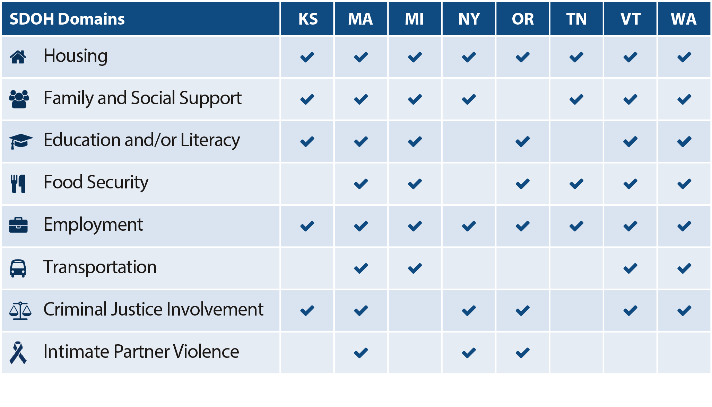
Spotlight on Selected States’ SDOH Domains*
*Data collected from Medicaid beneficiaries at the individual and/or population levels; data not systematically collected from the entire Medicaid population

Slide 11
Overview of State Approaches to VBP in Behavioral Health

Slide 12

Tennessee’s Health Care Innovation Initiative
Requires adoption of two state-designed models related to behavioral health:
  Tennessee Health Link – incentivizes care coordination for individuals with high BH needs
  Episodes of care: 20 retrospective episodes currently in place; 75 designed by 2020
    Currently in place: Depression (non-emergent), ADHD, ODD, anxiety
    Planned: Schizophrenia, bi-polar, drug dependence, depression (acute exacerbation)
Early episodes have shown success with respect to improved quality and reduced costs
12

Slide 13

Minnesota’s Integrated Health Partnerships
In 2013, MN launched its Medicaid ACO program,
Integrated Health Partnerships (IHPs)
Key IHP program features include:
  Shared savings payment arrangement, with upside/downside risk for larger systems and population-based payments for smaller systems
  Incorporates behavioral health into total cost of care and measures quality performance for mental health and substance use treatment
  21 IHPs oversee care for 465,000 enrollees, approximately 45% of MN Medicaid population
Accomplishments:
  Estimated savings of $156 million compared to trended targets, over first three years; IHPs received 85%+ of dollars at risk for quality

Slide 14

Arizona’s VBP Requirements for Behavioral Health
20% of Medicaid MCO payments must be linked to VBP, subject to 1% quality withhold
  At least 5% of payments for adults with SMI must be governed by VBP strategies for the contract year
  Minimum of 25% of the 5% requirement shall be with an organization that includes primary care providers
Plan will lose money if quality measures are not met
  Each plan can determine its approach
  To date, plans interested in testing bundled payments
AZ model is imitated by many other states

Slide 15

Plan-to-Provider Innovation in Pennsylvania
Pay-for-performance for Assertive Community Treatment (ACT) provider in Allegheny County, PA
  Initiative result of collaboration between the BH-MCO (Community Care), ACT providers, and community stakeholders
Key program features include:
  Tiered earnings from a bonus pool created by withholding 20% of established ACT service rate
  Providers can earn 20% withhold based on performance and 10% bonus if they meet cost target of < $9,000 per patient per calendar year
Accomplishments (win/win!):
  ACT providers earned full 20% withhold and 10% bonus, which increased revenue for ACT teams, while substantially reducing overall costs

Slide 16
Challenges and Best Practices for VBP in Behavioral Health

Slide 17

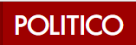



Finger on the Pulse
A Health Center in Alaska Brought Physical & Mental Health Under One Roof with Impressive Results. Why Isn’t it More Popular?
August 9, 2017 |
Value-Based Payment as Part of a Broader Strategy to Address the Opioid Addiction Crisis
December 1, 2017|
Medicaid managed care executives say plans must tackle social determinants, opioid epidemic
October 31, 2017 |
Pay for Performance Fails to Perform
November 27, 2017|

Slide 18

Challenges in Moving to VBP for
Behavioral Health in Medicaid
Varying levels of provider readiness
  Provider organizations at different levels of readiness (EHR capabilities, ability to accept risk, process maturity, etc.)
Lack of robust quality measures and data
  Cannot truly assess value without looking at cost & quality; continued concerns on data sharing for SUD (42 CFR Part 2)
Reliance on managed care organizations
  Need to clearly define responsibility and align incentives, especially for states with carve-out behavioral health plans
Alignment within and across payers/services
  Need to ensure not creating VBP silos instead of FFS silos

Slide 19

Factors to Consider in Moving to VBP for Behavioral Health
Start slowly and assess provider readiness for shifting to VBP
Engage stakeholders early and often
Ensure providers have opportunity to weigh in on the payment model design (e.g., PTAC)
Provide technical assistance
Align measures with other programs/payers
Ensure providers compensated fairly for treating complex patients

Slide 20
Spotlight on TennCare and MCO Stakeholder Engagement
Hospital and Practice Administrators
Clinicians
Government Departments & Agencies
Public
Employers
Medical Societies & Associations
Community Organizations
Contractors
Legislature

Slide 21

Spotlight on NY’s Technical Assistance for Plans & Providers
New York offers comprehensive technical assistance to plans and providers on VBP
  The Community Technical Assistance Center of New York (CTAC) and Managed Care Technical Assistance Center of New York (MCTAC) offer training, consultation, and educational resources for behavioral health agencies
  NY also offers a “VBP University”
 | Date of Release | Area of Study
Semester One | Released in July 2017 | Background and foundational information on VBP
Semester Two | August 2017-Now Live! | Topic specific information such as governance, business strategy, stakeholder engagement, finance, and data
Semester Three | September 2017 | VBP Contracting
Semester Four | October and November 2017 | VBP Bootcamps

Slide 22

State interest in VBP for behavioral health continues to grow, with focus on…
Integrating behavioral health into ACOs and other existing payment reforms
Implementing VBP through managed care contracts
Strengthening partnerships with community based providers
Watching for next steps from CMMI RFI

Slide 23





Visit CHCS.org to…
Download practical resources
to improve the quality and cost-effectiveness of Medicaid services
Learn about cutting-edge efforts to improve care for Medicaid’s highest-need, highest-cost beneficiaries
Subscribe to CHCS e-mail, blog
and social media updates to learn about new programs and resources
Follow us on Twitter @CHCShealth

