Slide 1
Federal Policy Update
Rebecca Farley David
National Council for Behavioral Health
December 5, 2017

Slide 2
Recent News From Washington
Congress faces action-packed December as gov’t funding expires Dec. 22. Also on its to do list:
Children’s Health Insurance Program reauthorization, Medicare extenders package, potential health care marketplace legislation, negotiations for extending the debt ceiling
Tax reform packages passed House and Senate
Executive actions on individual markets, essential health benefits.
Party leadership looking ahead to entitlement reform in 2018-2019
Bottom line: numerous threats to Medicaid, safety net still on the horizon

Slide 3
Where we’ve come…
Also included major cuts to Medicaid & commercial insurance, with devastating impact on people with serious chronic conditions

Slide 4
Common elements
Medicaid
Repeal Medicaid expansion option
Phase out enhanced federal match rate for Medicaid expansion
Convert Medicaid to a per-capita capped or block grant system
Net effects:
Cuts ~$880 billion from Medicaid over ten years
Makes it expensive and complicated for states to continue Medicaid expansion
Commercial Market
Establish waiver process for states to opt out of ACA requirements:
Waiving essential health benefits
Effect: States could permit the sale of plans that exclude key benefits, including MH/SUD care.
Waiving protections based on health and age
Effect: States could allow insurers to charge people w/ pre-existing conditions and older people higher premiums, pushing some out of affordable coverage.

Slide 6
“Sneaky Repeal”
Tax Cuts and Jobs Act (Senate version)
Repeals the individual mandate, increasing number of uninsured & likely resulting in increased premiums
Potentially opens door to smoother passage of future ACA repeal bill by reducing # of uninsured in CBO score?
Increases medical expense deduction, which protects those with costly and chronic conditions like mental illness or addiction.
Doubles the standard deduction, leading to a loss of up to $13.1 billion in charitable giving contributions annually.

Slide 7
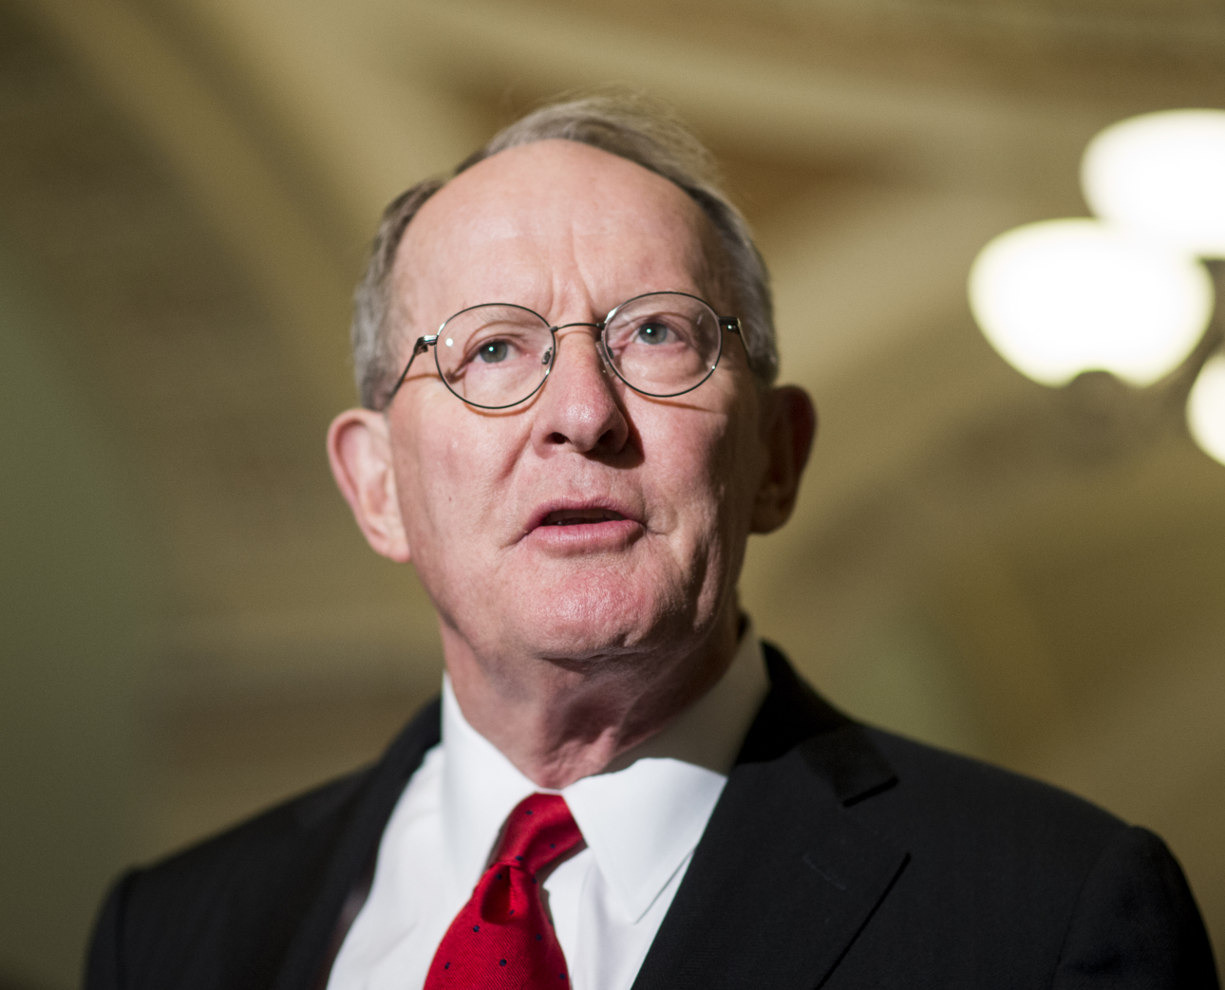
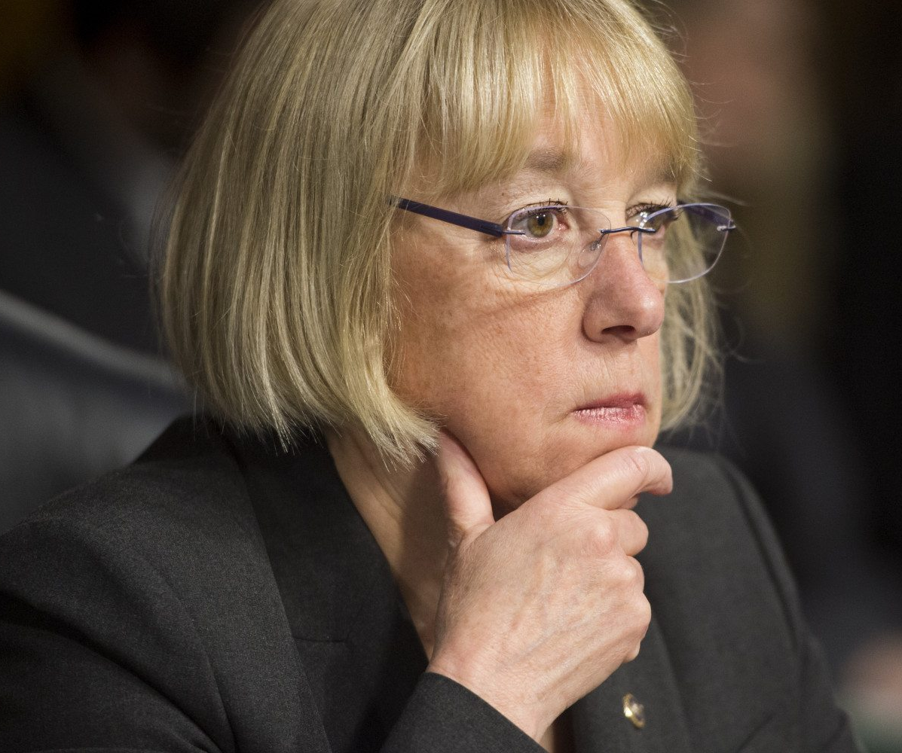
Market stabilization
Will it move, or not?
Bipartisan deal reached between Sens. Murray & Alexander
Two years of subsidy funding
Extend "copper plan" to people over 30
$106 million in enrollment outreach funding
Shorter review time for states seeking Section 1332 waivers
Funding to help states launch reinsurance programs
Could be used as a bargaining chip to lure Republicans to a “Yes” vote on tax reform plan.

Slide 8
CHIP Reauthorization
Authorization expired Sept. 30, 2017
Funding expected to run out in most states by March 2018
Some states already reporting depleted funds.
Reported agreement on details of CHIP extension… But no consensus yet on offsets.
Our goal: Reauthorize CHIP, ensure it’s paid for without cutting Medicaid.

Slide 9
FY 2018 Appropriations
President’s Budget Request
+$500 million for opioids, -$300 million across the board at SAMHSA, key SAMHSA programs zeroed out
House Appropriations Committee-approved
-$300 million across the board at SAMHSA, -$141 million from Mental Health Block Grant, +$1.1 billion for NIH funding, level funding for key SAMHSA programs (PBHCI, MHFA)
Senate Appropriations Committee-approved
+$500 million for opioids, +$13 million at SAMHSA, level funding for key SAMHSA programs, +$2 billion for NIH funding
Next funding deadline: Dec. 22, 2017

Slide 10
Meanwhile, at the White House…
Action on CSRs, association health plans
CSRs
Association Health Plans
Plans to end $7B in subsidies that help low-income consumers purchase coverage
Affects people 100-250% FPL in silver plans
Insurers’ rates for 2018 already locked in
The litigation begins…
Executive order reinterprets AHPs as ERISA plans (largely exempt from ACA coverage requirements)
Allows sale of AHPs across state lines by employers in the same line of business
Rulemaking required

Slide 11
Proposed changes to essential health benefits
Would open the door to less comprehensive EHB by allowing states to:
Choose plans (and benefit categories) from other states
Substitute one category of benefits for another
Create a new benefit plan from scratch
HHS considering a “federal default definition of essential health benefits”
Could include a “national benchmark plan standard” that would shift costs to states for more generous coverage

Slide 12
What do we know about what’s ahead?
Notes:
This presentation is for the Indiana Council (State Association)

Slide 13
“We’re going to have to get back next year at entitlement reform, which is how you tackle the debt and the deficit. [Medicare & Medicaid] are the big drivers of debt… that's really where the problem lies, fiscally speaking.”
–House Speaker Paul Ryan
Dec. 6, 2017

Slide 14
What will it look like?
Executive action | Legislative action
Top-to-bottom review of safety net programs Encouraging work requirements in Medicaid Permitting work requirements, drug testing in SNAP “Greater control” for states over SNAP HUD “significantly involved” | Tightening eligibility rules for federal programs Legislation likely to touch on health care, food stamps, housing, veterans programs Social Security and Medicare impact unknown

Slide 15
Will it succeed?
Reluctance to abandon ACA repeal
Midterm election year complicates major efforts
Single-party control boosts long-sought Republican goals
Strong commitment from Congress & White House

Slide 16
“Today, we commit to ushering in a new era for the federal and state Medicaid partnership where states have more freedom to design programs that meet the spectrum of diverse needs of their Medicaid population…”
–Former Sec. Tom Price & Administrator Seema Verma

Slide 17
Likely Medicaid waiver proposals
Work requirements
Drug testing
Higher cost sharing
Use of HSAs
Special enrollment & lockout periods
Time limit on coverage
“Disability” is often touted as a category of exemption from new waiver requirements.
Notes:
“Disability” as a category for exemption
Does not include people with addiction
Does not include people with moderate-severity conditions accompanied by cognitive impairments
“Medically frail” may be a better exemption category
Education of policymakers is needed!

Slide 18
New legislation in 2017
Excellence in Mental Health and Addiction Treatment Expansion Act: More states allowed to implement CCBHCs
Mental Health Access Improvement Act: Medicaid billing for MFTs/MHCs
Strengthening the Addiction Treatment Workforce Act: Loan forgiveness for professionals in addiction settings
Behavioral Health IT Act: Demonstration to help BH providers adopt electronic health records
Other bills introduced: CHRONIC Care Act (Wyden/Grassley), Family First Prevention Services Act (Wyden/Hatch), Medicaid CARE Act (Durbin/Portman) and others… HIPAA… telehealth?
Notes:
NOTE: CAVEAT…
Investment via grants, not coverage
Need for health-related “moving vehicles” to pass any of these bills

Slide 19
Caveats
Changes to other federal programs undermine other safety net supports
Investment via grants, not coverage
Need for “moving vehicles” to pass any health legislation

Slide 20
Our federal advocacy goals
Preserve/protect programs & funding
Start laying the foundation now
Establish strong relationships w/ legislators & staff
Share info about communities/populations served
Educate about tx/prevention/ recovery services
Invite them for a site visit

Slide 21
Lots of ways to deliver the message!
www.thenationalcouncil.org/policy-action/unite4bh

Slide 22
As former Senate Majority Leader Everett Dirksen (R-IL) said…
“When I feel the heat, I see the light.”

Slide 23
Gaylord National Resort & Convention Center
201 Water Street, National Harbor, MD 20745

Slide 24
Questions?
Rebecca Farley David
Vice President, Policy and Advocacy
RebeccaD@thenationalcouncil.org

